Slide 1
Library preparation
Please revise slides 2-8 before the workshop

Slide 2
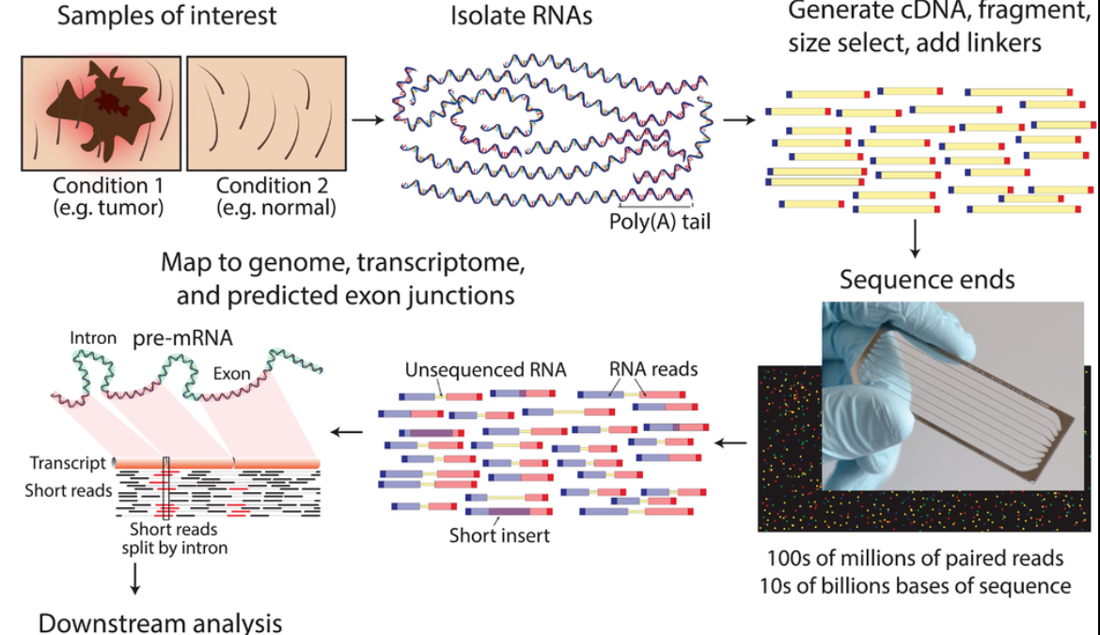
RNA-seq - experiment
mean length of 300 bp (typically ranging 200–700 bp
https://www.wikiwand.com/en/RNA-Seq

Slide 3
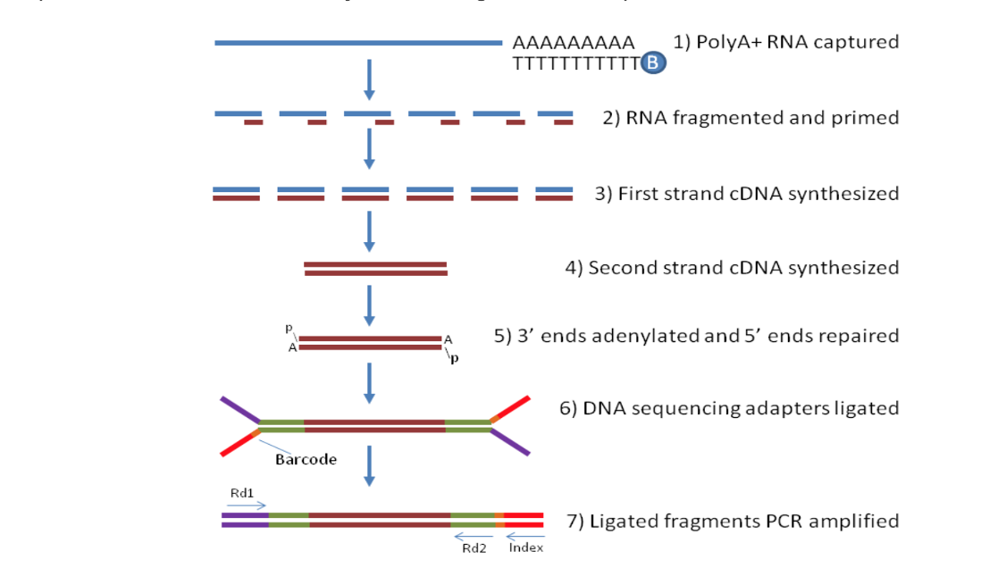
How does the bulk-RNA-seq technology work?
Notes:
From http://rockefelleruniversity.github.io/RU_RNAseq/
More details here: https://rnaseq.uoregon.edu/#rna-prep-overview

Slide 4
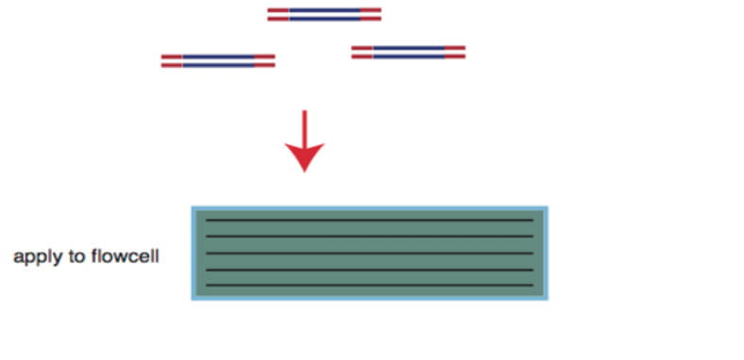
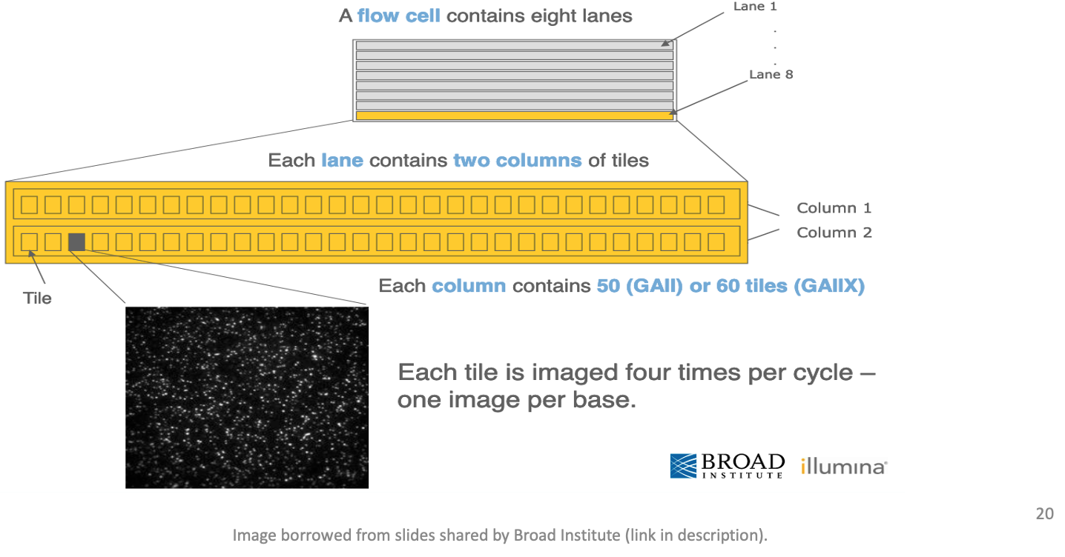
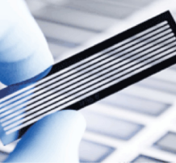
Flow cell organization for sequencing
cDNA library is applied to a flow cell
Notes:
From https://www.broadinstitute.org/files/shared/illuminavids/sequencingSlides.pdf

Slide 5
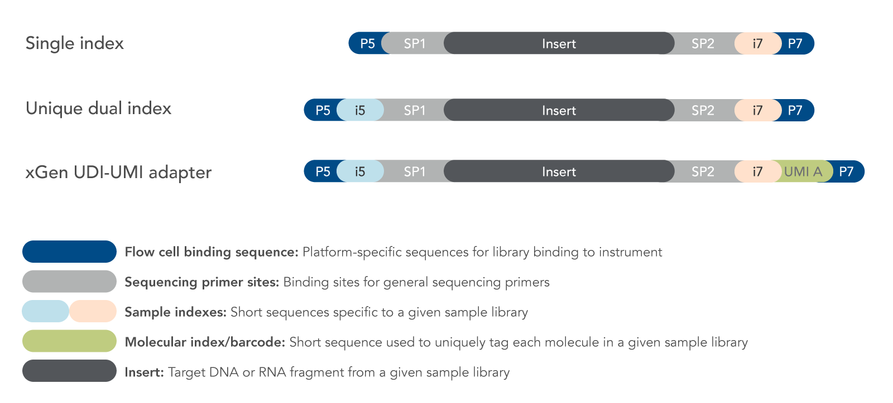
Fragments preparation for the sequencer
Notes:
From http://rockefelleruniversity.github.io/RU_RNAseq/
More details here: https://rnaseq.uoregon.edu/#rna-prep-working-with-rna

Slide 6
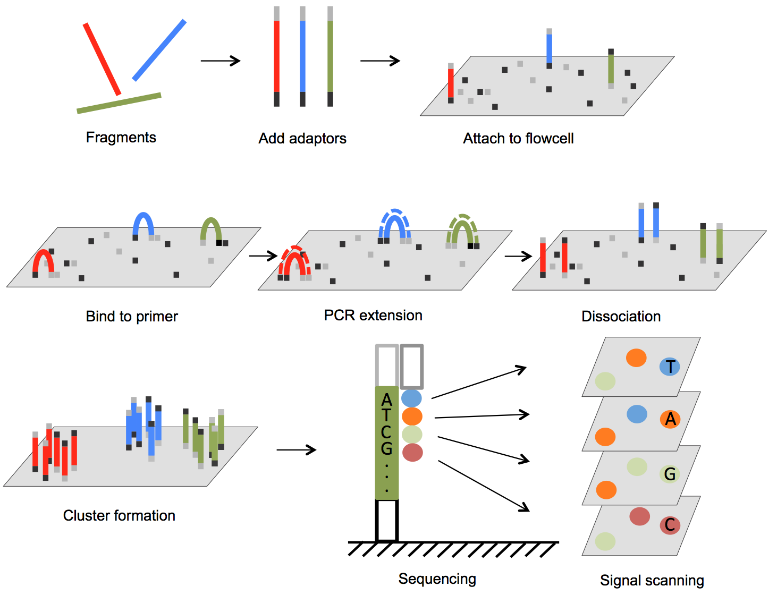
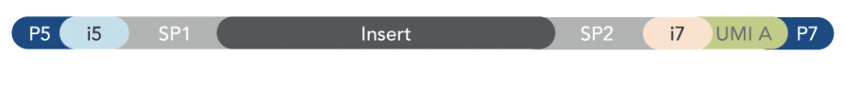

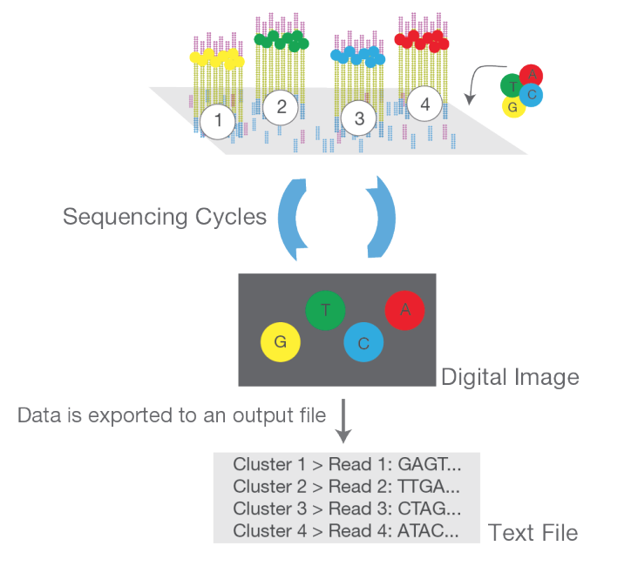

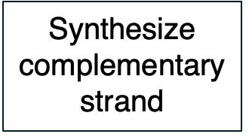

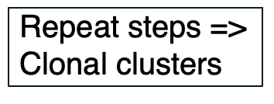
DNA fragments immobilized on flow cell & amplified into clonal clusters
ds cDNA > ss cDNA
From DOI: 10.5772/61657 and https://www.illumina.com/content/dam/illumina-marketing/documents/products/illumina_sequencing_introduction.pdf
Notes:
Cluster amplification: https://youtu.be/3URxJD5k3T8

Slide 7
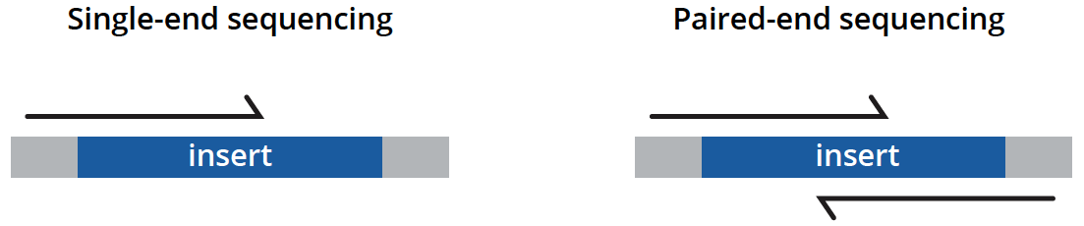
Types of sequencing
unidirectionally - sequencing from one end only
less expensive, is typically reserved for quantifying gene expression in well-annotated genomes and analyzing small RNA molecules.
bidirectionally - both ends of DNA fragments to be sequenced
usually recommended for most applications as it provides richer data and permits longer library insert sizes.
https://www.genewiz.com/
Notes:
Suggesting reading https://bmcbioinformatics.biomedcentral.com/articles/10.1186/s12859-020-3484-z

Slide 8
Library preparation affects the downstream analysis
RNA quality is fundamental
RNA extraction method can affect the transcript abundance
Choice of platform and library preparation protocol

Slide 9


Slide 10
Introduction to RNA-seq data analysis
Michela Traglia, Ayushi Agrawal
Bioinformatics Core, GIDB
September 28-29, 2026

Slide 11
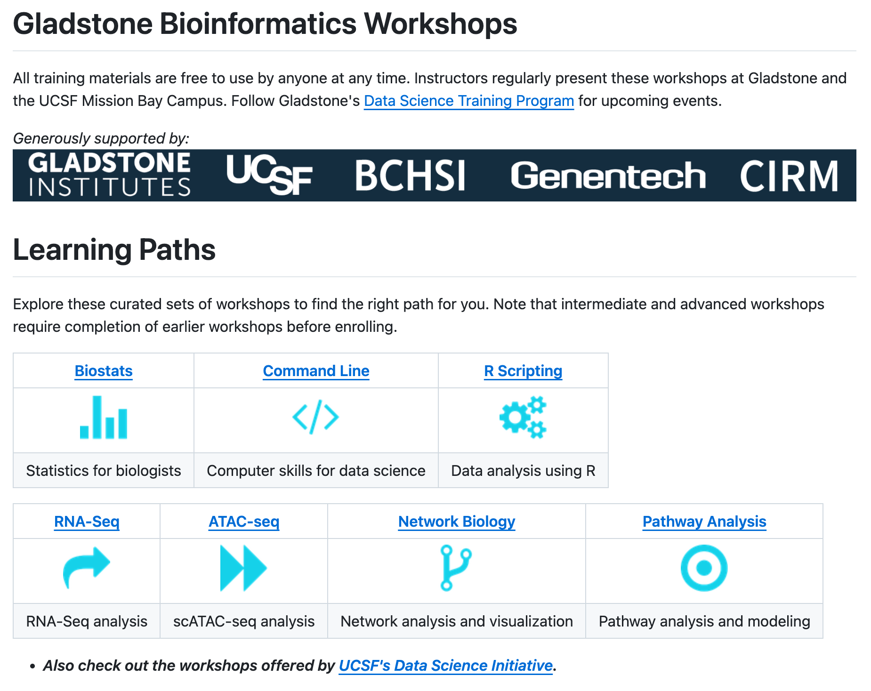


Slide 12
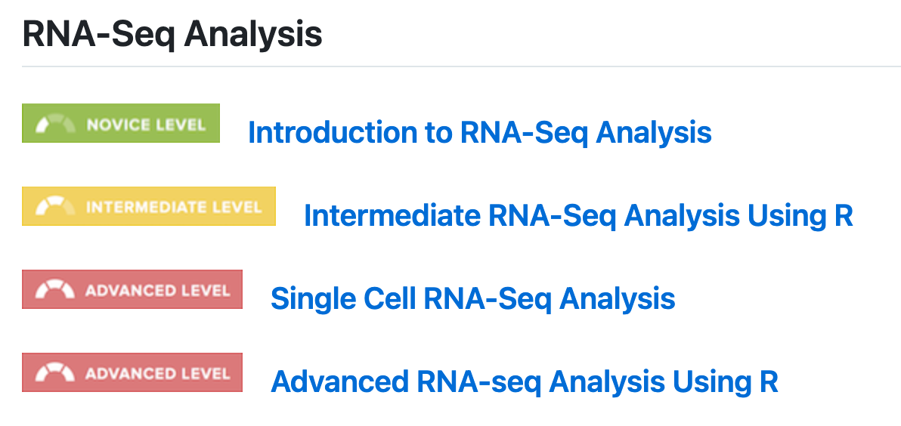
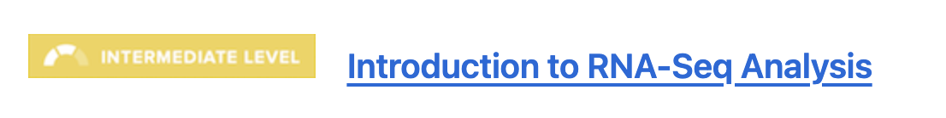


Slide 13
Introductions
Michela Traglia
Senior Statistician
Ayushi Agrawal
Senior Bioinformatician

Slide 14
Workshop sessions
Session I
Monday - September 28
9-12p
Session II
Monday - September 28
1-3 pm
Session III
Tuesday - September 29
1-3 pm

Slide 15
Working material for this workshop
Session I-II-III
Slides
Session I-II - Hands-on materials
Session III - Hands-on materials
Please install Docker https://www.docker.com/products/docker-desktop/

Slide 16
What to expect from this workshop
Demystify each step of the RNA-Seq data analysis
Understand bioinformatic analysis steps from raw data to DEG
Enable informed conversations with computational biologists
Demonstrate how to process a mock dataset and get a count matrix using docker
Perform the normalization and DEG analysis with a real dataset using R packages
Not to provide end-to-end fits all analysis pipeline
Notes:
This slide deck gives an overview of the tools and tech underlying RNA-seq.
Docker (https://www.docker.com/) is a software platform that allows you to build, test, and deploy applications quickly. Docker packages software into standardized units called containers that have everything the software needs to run including libraries, system tools, code, and runtime. Using Docker, you can quickly deploy and scale applications into any environment and know your code will run.
What is an HPC? https://insidehpc.com/hpc-basic-training/what-is-hpc/

Slide 17
Target audience
Session I and II: from sequencer to count matrix
Ideal for beginners with no prior experience; it might feel slow if you are already familiar with the concepts.
Session III: from count matrix to DEG
Familiarity with basic concepts of statistics and hypothesis testing
For the demos - expected familiarity with command line, R and RStudio

Slide 18
Poll 1
Which is your expectation from this workshop?
I want to:
1) Analyze my RNA-seq raw data
2) Improve my existing analysis pipeline settings
3) Learn about RNA-seq analysis
Please select all that apply.

Slide 19
Workshop outline
Session 1
From sequencer to adapter trimming
Session 2
From trimming to count amtrix
Session 3
From count matrix to DEGs

Slide 20
Workshop outline
Session I
RNA-seq analysis overview
Understanding the sequencer output
Quality checks
Trimming of adapters
Break
Introduction to docker and setup
Demo - QC steps
Session II
Mapping the read to reference genome
From alignment to counting features
Break
Demo - from Mapping to the count matrix
Session III
Filtering low counts genes
Dimensionality reduction
Normalization
Break
Model fitting
DEG and visualization
Break
Demo - from count matrix to DEG

Slide 21
Production-ready pipelines: nf-core/rnaseq
What you will learn today:
Individual tools (FastQC, cutadapt, STAR, featureCounts)
What we use at Gladstone Bioinformatics Core:
Automated pipelines (nf-core/rnaseq)
• Runs all steps automatically
• Handles batch processing (100+ samples)
• Built-in best practices
• Comprehensive quality reports
🔗 nf-core/rnaseq documentation:
https://nf-co.re/rnaseq

Slide 22
Why learn manual steps first?
• Debugging: Know where the pipeline failed
• Customization: Not all projects fit defaults
• Understanding: Interpret results properly
• Troubleshooting: Fix issues when they arise
Understanding the steps makes you a better bioinformatician and computational biologist.
🔗 nf-core/rnaseq documentation:
https://nf-co.re/rnaseq

Slide 23
Session 1
From sequencer to adapter trimming
Tools: Docker, FastaQC, cutadapt

Slide 24

RNA-seq - analysis workflow (A)
Biological question
Library preparation
Sequencer: Reads Fastq
Quality check
FastQC
Session 1 Demo
Session 1 Concepts:
Trimming
cutadapt
Quality check
FastQC
Alignment/Mapping
STAR
Quality check
Session 2 Concepts:
Session 2 Demo
Counting Reads
featureCounts
Quality check
Count Matrix
Notes:
Sequencing centers often provide reads in the FASTQ format. The raw reads contain sequences of adapters added during library preparation, which are trimmed to start with. Then, the reads are typically mapped to a reference genome sequence. Counts of reads mapping to genes are tallied and used for differential gene expression analysis. At all stages, it is important to perform quality control of the data. All the tools mentioned in the subsequent slides for these steps are available via docker or can be installed locally.
Please download and install Docker Desktop from: https://docs.docker.com/get-docker/
All UCSF/Gladstone affiliates can request access to Wynton. Visit https://wynton.ucsf.edu/hpc/about/join.html

Slide 25
RNA-seq - analysis workflow (B)
Count matrix
Source of variability
Filtering low counts genes
Dimensionality reduction
Session 3 Concepts:
Normalization
Fit the model
DEG and visualization
Session 3 Demo
Notes:
Sequencing centers often provide reads in the FASTQ format. The raw reads contain sequences of adapters added during library preparation, which are trimmed to start with. Then, the reads are typically mapped to a reference genome sequence. Counts of reads mapping to genes are tallied and used for differential gene expression analysis. At all stages, it is important to perform quality control of the data. All the tools mentioned in the subsequent slides for these steps are available via docker or can be installed locally.
Please download and install Docker Desktop from: https://docs.docker.com/get-docker/
All UCSF/Gladstone affiliates can request access to Wynton. Visit https://wynton.ucsf.edu/hpc/about/join.html

Slide 26

Bulk RNA-seq - experiment
mean length of 300 bp (typically ranging 200–700 bp)
https://www.wikiwand.com/en/RNA-Seq

Slide 27
Biological question
Library preparation
Sequencer: Reads Fastq
Quality check
FastQC
Session 1 Demo
Session 1 Concepts:
Trimming
cutadapt
Quality check
FastQC
Alignment/Mapping
STAR
Quality check
Session 2 Concepts:
Session 2 Demo
Counting Reads
featureCounts
Quality check
Count Matrix
Notes:
Sequencing centers often provide reads in the FASTQ format. The raw reads contain sequences of adapters added during library preparation, which are trimmed to start with. Then, the reads are typically mapped to a reference genome sequence. Counts of reads mapping to genes are tallied and used for differential gene expression analysis. At all stages, it is important to perform quality control of the data. All the tools mentioned in the subsequent slides for these steps are available via docker or can be installed locally.
Please download and install Docker Desktop from: https://docs.docker.com/get-docker/
All UCSF/Gladstone affiliates can request access to Wynton. Visit https://wynton.ucsf.edu/hpc/about/join.html

Slide 28
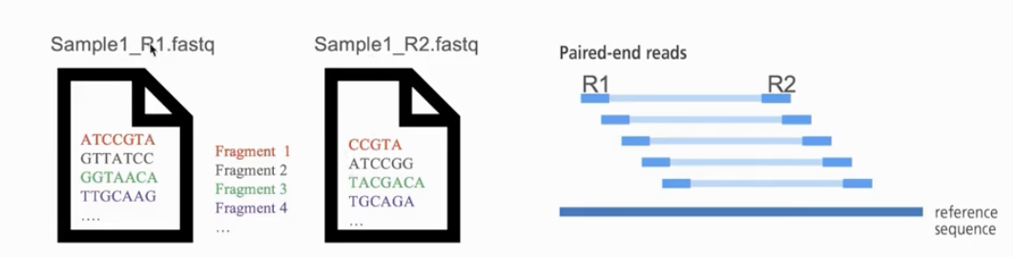
Naming conventions for fastq files
File names often follow a format.
  SampleName_SampleNumber_LaneNumber_ReadNumber_SetNumber.fastq
  Eg – Bacteria_S1_L001_R1_001.fastq
Paired-end reads named with R1 and R2 in file name.
  Eg – Bacteria_GATTACA_L001_R1_001.fastq and Bacteria_GATTACA_L001_R2_001.fastq
File extensions may be .fq or even .txt
Often compressed using gzip.
  gzip is free and open-source.
  Resulting file names have .gz added. Example – .fq.gz.
Notes:
File names samplename_S1_L001_R1_001.fastq.gz
samplename—The sample name provided in the sample sheet. If a sample name is not provided, the file name includes the sample ID, which is a required field in the sample sheet and must be unique.
S1—The sample number based on the order that samples are listed in the sample sheet starting with 1. In this example, S1 indicates that this sample is the first sample listed in the sample sheet.
L001—The lane number.
R1—The read. In this example, R1 means Read 1. For a paired-end run, there is at least one file with R2 in the file name for Read 2.
001—The last segment is always 001

Slide 29
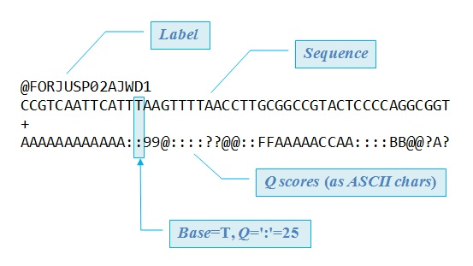
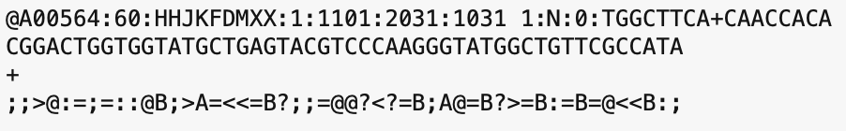

FASTQ files are text files with detailed information about each read.
Image adapted from Robert Edgar's web site https://www.drive5.com/

Slide 30
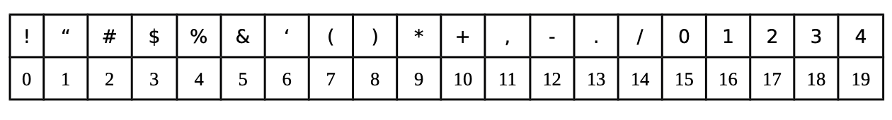
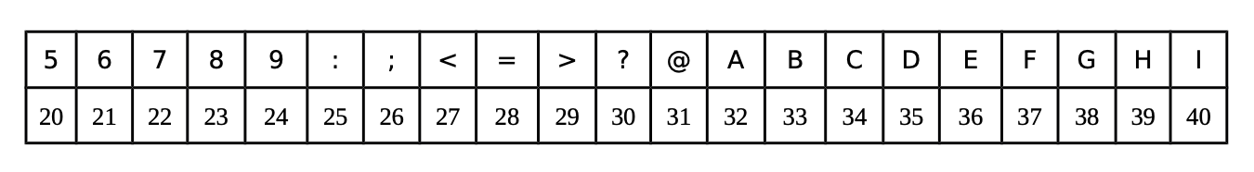
Quality score encoding based on ASCII table
Measurement of the likelihood that a base call in DNA sequencing is incorrect
Each symbol is a probability p that the base call is incorrect.
The standard Sanger sequencing score to assess reliability of a base call is Q=−10 log10(p)
p, the probability that a given base is incorrectly called
Notes:
https://www.illumina.com/science/technology/next-generation-sequencing/plan-experiments/quality-scores.html

Slide 31
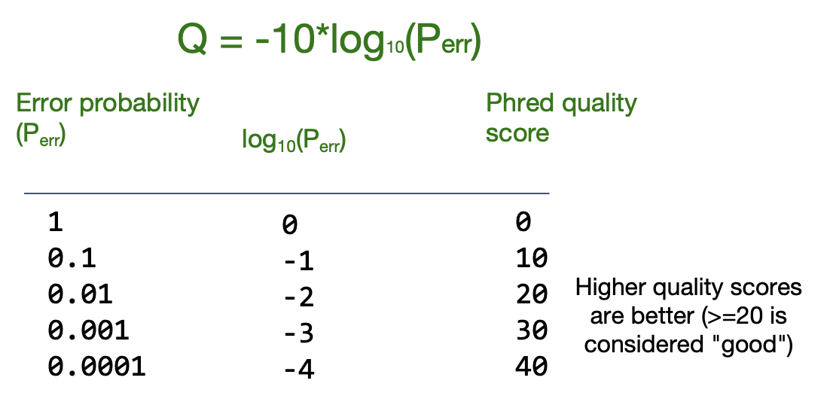
Phred quality score calculation
A quality score of 20 (Q20) represents an error rate of 1 in 100 (meaning every 100 bp sequencing read may contain an error), with a corresponding call accuracy of 99%.

Slide 32
Poll 2
What is the Q-score (ASCII) of the 3rd base?
@SIM:1:FCX:1:15:6329:1045 1:N:0:2
TCGCACTCAACGCCCTGCATA
+
<>;##=><9=AAAAAAAAA9#
G
>
;
I
None of the above

Slide 33
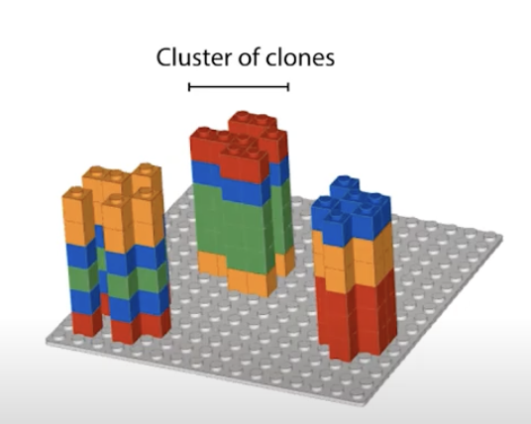
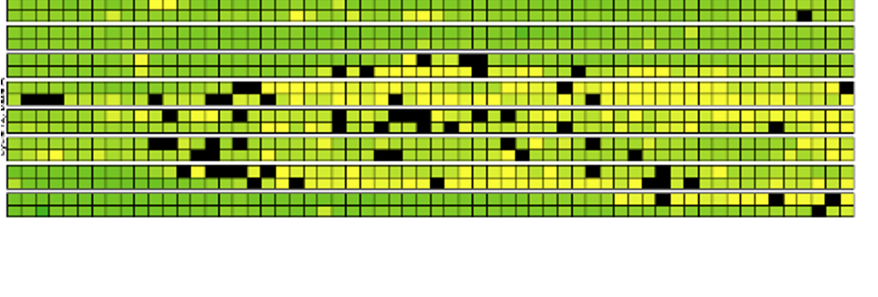
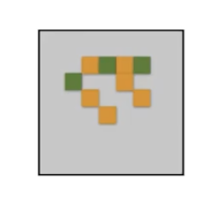
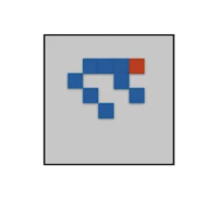
Base calling may not be accurate
Possible causes
Blocking of synthesis after one nucleotide addition may be inefficient.
Clusters might not be monoclonal.
A tile may be out of focus.
Oil, reagent, etc. on flow cell or imaging component, etc.
=> Need to record quality of each base call.
Notes:
https://www.youtube.com/watch?v=U4QnpciIJhM

Slide 34
FastQC: Quality check of sequencing data
Summarizes quality of base calls
Any sequences more frequently observed than expected?
Any sequence biases?
Any GC biases?
Checks for presence of known adapters
Notes:
For more: https://rtsf.natsci.msu.edu/genomics/tech-notes/fastqc-tutorial-and-faq/

Slide 35
Examples of FastQC reports
Good Illumina data: https://www.bioinformatics.babraham.ac.uk/projects/fastqc/good_sequence_short_fastqc.html
Bad Illumina data: https://www.bioinformatics.babraham.ac.uk/projects/fastqc/bad_sequence_fastqc.html

Slide 36
What if QC gives warn/fail flag?
Non-normal GC content per read?
  Normal expected for whole-genome shotgun sequencing.
  RNA-seq might give different distributions.
Non-uniform sequence content per nucleotide?
  First 10-15 nt in RNA-seq often non-uniform.
High duplication levels or overrepresented sequences?
  Are they contaminants, e,g. adapters or PCR duplicates?
  If so, clean up contaminants.
  Could be attributed to highly abundant transcripts.
Notes:
https://sequencing.qcfail.com/articles/positional-sequence-bias-in-random-primed-libraries/

Slide 37
Biological question
Library preparation
Sequencer: Reads Fastq
Quality check
FastQC
Session 1 Demo
Session 1 Concepts:
Trimming
cutadapt
Quality check
FastQC
Alignment/Mapping
STAR
Quality check
Session 2 Concepts:
Session 2 Demo
Counting Reads
featureCounts
Quality check
Count Matrix
Notes:
Sequencing centers often provide reads in the FASTQ format. The raw reads contain sequences of adapters added during library preparation, which are trimmed to start with. Then, the reads are typically mapped to a reference genome sequence. Counts of reads mapping to genes are tallied and used for differential gene expression analysis. At all stages, it is important to perform quality control of the data. All the tools mentioned in the subsequent slides for these steps are available via docker or can be installed locally.
Please download and install Docker Desktop from: https://docs.docker.com/get-docker/
All UCSF/Gladstone affiliates can request access to Wynton. Visit https://wynton.ucsf.edu/hpc/about/join.html

Slide 38
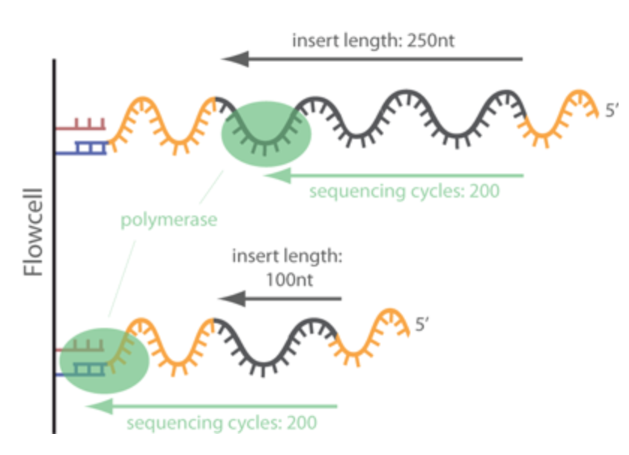
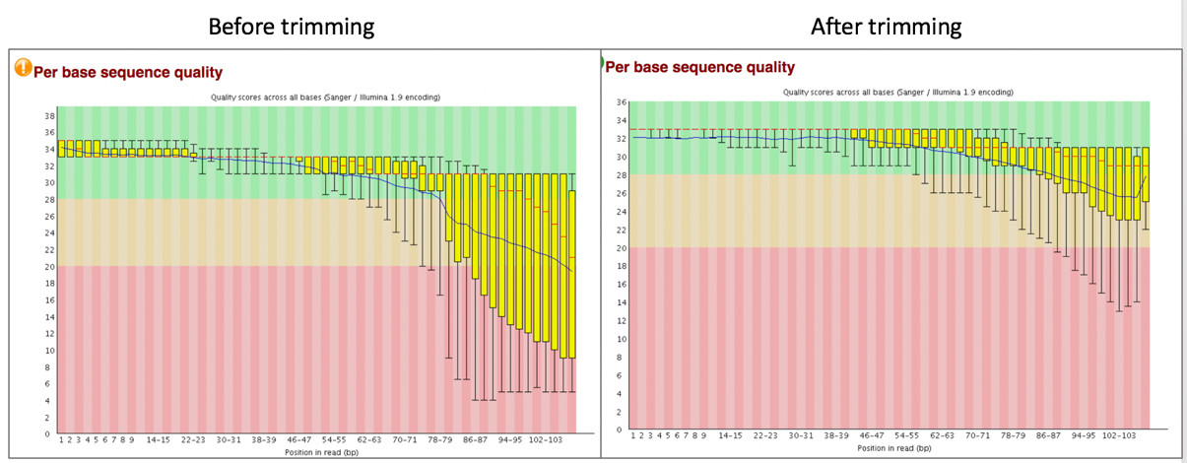
Trimming - Removing adapters
Tools: cutadapt, Trimmomatic
Notes:
https://www.ecseq.com/support/ngs/trimming-adapter-sequences-is-it-necessary

Slide 39
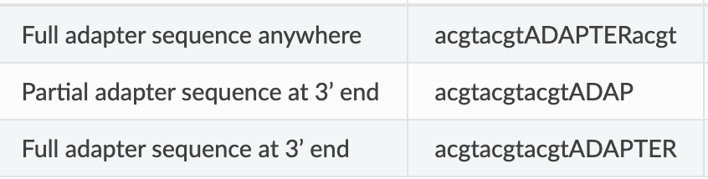
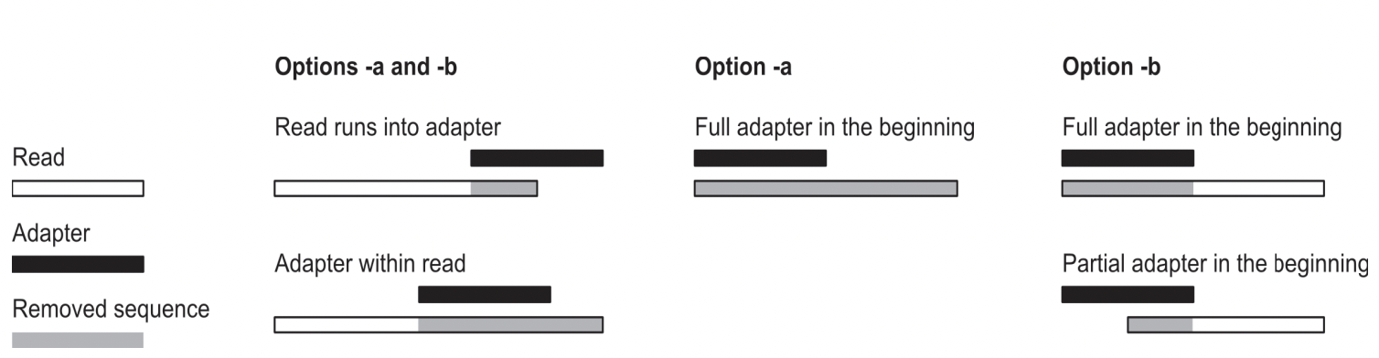


cutadapt removes adapters
Search for adapter sequence in read.
Allow for mismatches in sequence.
If significant alignment, cut.
5’
3’
5’
3’
5’
3’
5’
3’
Forward read ->
Set max error rate (default 1%)
Min overlap (default 3)
Aligned region
5’
3’
The actual error rate is computed as the number of errors in the match divided by the length of the matching part of the adapter.
<- Reverse read
Notes:
https://cutadapt.readthedocs.io/en/stable/guide.html

Slide 40
Poll 3
How are you feeling about the content covered so far?
Great - I am getting it
Okay - I am hanging in there
I am learning a lot
I need help

Slide 41
Break
(5 min)
Please drop a question in the chat or speak up

Slide 42
Biological question
Library preparation
Sequencer: Reads Fastq
Quality check
FastQC
Session 1 Demo
Session 1 Concepts:
Trimming
cutadapt
Quality check
FastQC
Alignment/Mapping
STAR
Quality check
Session 2 Concepts:
Session 2 Demo
Counting Reads
featureCounts
Quality check
Count Matrix
Notes:
Sequencing centers often provide reads in the FASTQ format. The raw reads contain sequences of adapters added during library preparation, which are trimmed to start with. Then, the reads are typically mapped to a reference genome sequence. Counts of reads mapping to genes are tallied and used for differential gene expression analysis. At all stages, it is important to perform quality control of the data. All the tools mentioned in the subsequent slides for these steps are available via docker or can be installed locally.
Please download and install Docker Desktop from: https://docs.docker.com/get-docker/
All UCSF/Gladstone affiliates can request access to Wynton. Visit https://wynton.ucsf.edu/hpc/about/join.html

Slide 43
Bioinformatics software ecosystem
Tools that “do one thing, and do it well”.
Tools for this workshop: fastqc, cutadapt, STAR, featureCounts
    Available via docker hub
    Some are pre-installed on Wynton; others we can install ourselves
    Download a container with all tools installed; use anywhere
    Everything can be installed on a laptop
Notes:
Login to a Wynton dev node and search for the tools using module spider

Slide 44
Different platforms for computing
Web-based platforms
Graphical User Interface
Command Line Interface
etc..

Slide 45
Galaxy: Open source, web-based platform that integrates many tools.
Free, public, internet accessible resource.
  https://usegalaxy.org/
Data transfer and data storage are not encrypted.
  DO NOT UPLOAD PROTECTED DATA!!!
Notes:
Galaxy provides a collection of tools to analyze variety of biomedical data
https://usegalaxy.org/

Slide 46
Command line interfaces allow scripting
Graphical User Interface
    Consists of windows, icons, menus, pointers
    Not always available for bioinformatics
Command Line Interface
    Text based
    Allow automation by scripting
    Examples
        Wynton CLI
        MacOS: Terminal
        Windows: Command Prompt, PuTTY

Slide 47
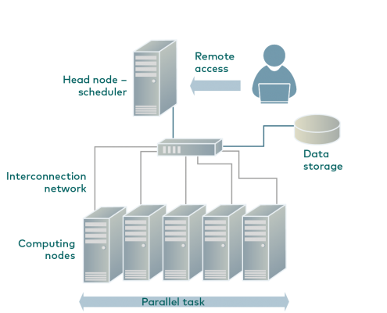
Wynton is a high-performance computing (HPC) system for UCSF affiliates
How to access Wynton? Visit:
  https://wynton.ucsf.edu/hpc/get-started/access-cluster.html
Most universities/ institutions doing data-intensive science have HPC cluster on campus.
(see Description for image source)
Notes:
Image taken from https://hpc.rtu.lv/introduction-to-hpc/?lang=en

Slide 48
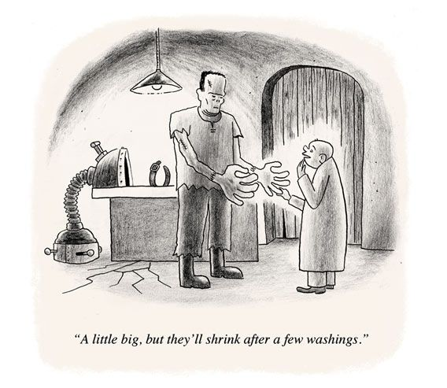
Containers enable reproducibility
Tools are constantly under development
  => Many versions around
Dependencies complicate installations
  Dependencies are also constantly under development
  => Many versions around
Different labs use different programming languages

Slide 49
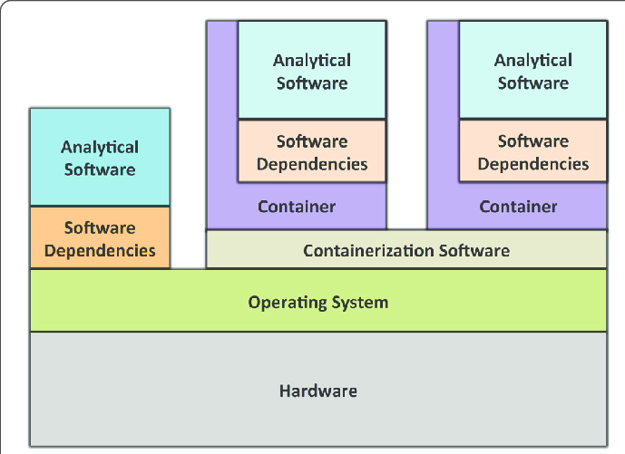
A container is like a computer within a computer
Containerization software examples:
  Singularity
  Docker (has security issues in the context of HPC)
Containers can be deployed on commercial cloud computing platforms, e.g., Amazon Web Services
(see Description for image source)
Notes:
Image source: https://gigascience.biomedcentral.com/track/pdf/10.1186/s13742-016-0135-4
Paper introducing Singularity: https://journals.plos.org/plosone/article/file?id=10.1371/journal.pone.0177459&type=printable
https://phoenixnap.com/kb/docker-image-vs-container

Slide 50
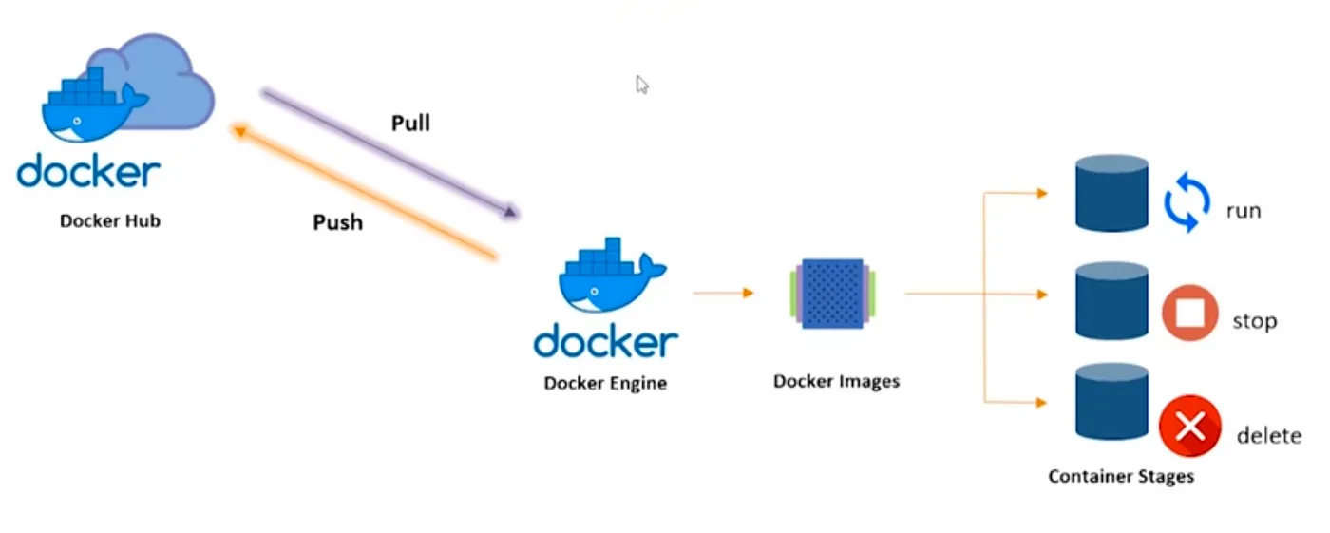
Docker Container Lifecycle
Image source: https://pradeep-sg406.medium.com/introduction-to-docker-5212421782df

Slide 51
Typical command line syntax of bioinformatics tools
$ Toolname [options] input
$ Toolname --paramA 10 –b file.txt –c xyz.fq –outFile pqrs.tuv
Examples:
$ fastqc –t 16 –o ./ Bacteria_GATTACA_L001_R1_001.fastq
$ fastqc *.fastq
$ cutadapt –a GATTACA –o ./trimmed.fastq input.fastq

Slide 52
File paths := Location of file on computer
./ is for current working directory
../ is for parent directory of current working directory
../../ is for parent directory of parent directory of current working directory
Example: If you are currently in data folder, then
fastqc ./raw.fastq -o ./results/
/home/
└── data/
├── raw.fastq
└── results/
└── out.txt

Slide 53
Dataset
Source Study: This dataset comes from a study characterizing the transcriptomic changes in human airway smooth muscle (ASM) cells in response to glucocorticoids, which are standard treatments for asthma. (Himes et al., 2014, PLOS ONE)
Experimental Conditions: Primary human ASM cell lines were treated with 1 µM Dexamethasone (a potent synthetic glucocorticoid) or a control vehicle for 18 hours.
Samples in this Workshop:
  N61311 cell line - Untreated (Control)
  N61311 cell line - Dexamethasone treated
Workshop Optimization: To facilitate local analysis and reduce computational load, the raw reads for these samples have been subsampled to include only those mapping to chromosome 16 (chr16).
Significance: The original study used RNA-Seq to identify 316 differentially expressed genes, notably identifying CRISPLD2 as a novel gene that modulates the anti-inflammatory effects of glucocorticoids in the airway

Slide 54
Poll 4
Which operating system will you use for the hands-on section?
Mac - Intel chip
Mac - Apple chip
Windows
Linux

Slide 55
Demo
Docker desktop installation (https://www.docker.com/products/docker-desktop/ )
(https://docs.docker.com/desktop/install/windows-install/ )
How to access public datasets?
  Downloading data from GEO
    https://bioinformaticsworkbook.org/dataAcquisition/fileTransfer/sra.html#gsc.tab=0
    https://erilu.github.io/python-fastq-downloader/

Slide 56
Poll 5
How is the pace?
Too fast - please go slower
Just right - keep going at the same pace
Too slow - please go faster

Slide 57
Session II
See you today at 1.05p

Slide 59
Introduction to RNA-seq data analysis
Michela Traglia, Ayushi Agrawal
Bioinformatics Core, GIDB
September 28-29, 2026

Slide 60
Workshop outline
Session I
RNA-seq analysis overview
Understanding the sequencer output
Quality checks
Trimming of adapters
Break
Introduction to docker and setup
Demo - QC steps
Session II
Mapping the read to reference genome
From alignment to counting features
Break
Demo - from Mapping to the count matrix
Session III
Filtering low counts genes
Dimensionality reduction
Normalization
Break
Model fitting
DEG and visualization
Break
Demo - from count matrix to DEG

Slide 61
Session 2
Alignment/mapping and feature counts
Tools: Docker, STAR, featureCounts

Slide 62
Biological question
Library preparation
Sequencer: Reads Fastq
Quality check
FastQC
Session 1 Demo
Session 1 Concepts:
Trimming
cutadapt
Quality check
FastQC
Alignment/Mapping
STAR
Quality check
Session 2 Concepts:
Session 2 Demo
Counting Reads
featureCounts
Quality check
Count Matrix
Notes:
Sequencing centers often provide reads in the FASTQ format. The raw reads contain sequences of adapters added during library preparation, which are trimmed to start with. Then, the reads are typically mapped to a reference genome sequence. Counts of reads mapping to genes are tallied and used for differential gene expression analysis. At all stages, it is important to perform quality control of the data. All the tools mentioned in the subsequent slides for these steps are available via docker or can be installed locally.
Please download and install Docker Desktop from: https://docs.docker.com/get-docker/
All UCSF/Gladstone affiliates can request access to Wynton. Visit https://wynton.ucsf.edu/hpc/about/join.html

Slide 63
Bulk mRNA-seq - summary

Slide 64
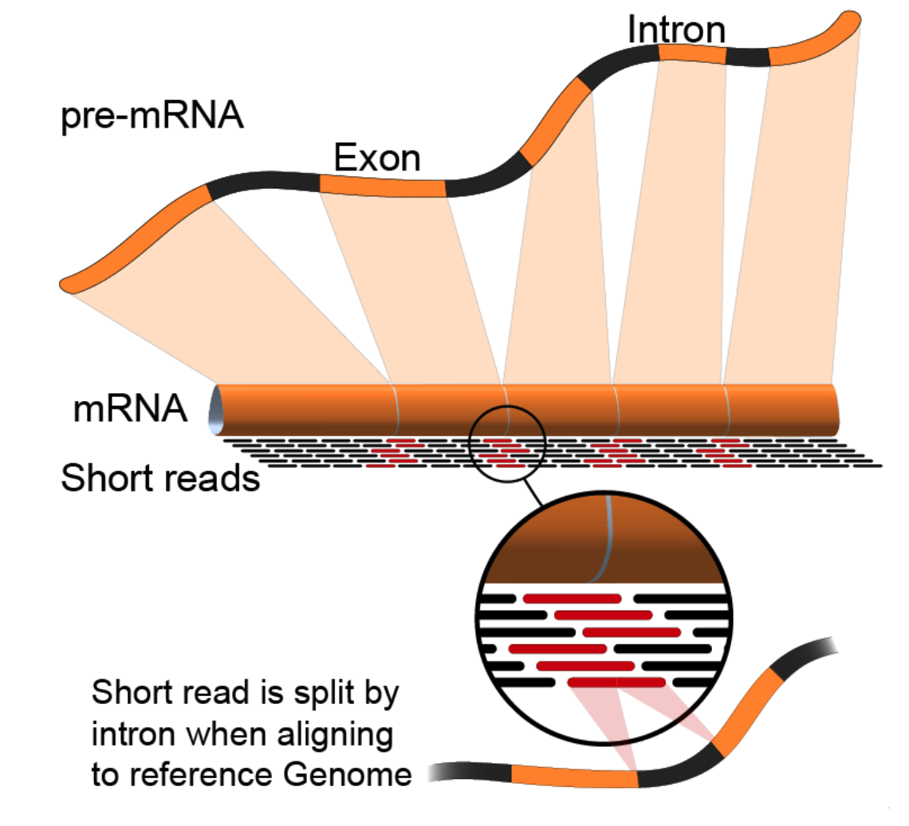
Alignment to genome : challenges
Reads from junctions: one part of it maps to one exon and the other half maps to the other exon
Reference sequences can be very long (~3 billion bp for humans).
Order of 100 million reads to be mapped.
Need to account for splicing.
Allow for PCR artifacts/sequencing errors.
Notes:
Suggested reading:
https://www.ncbi.nlm.nih.gov/pmc/articles/PMC3322381/pdf/nihms-366740.pdf
https://academic.oup.com/bioinformatics/article/29/1/15/272537
Video lectures on how these mapping tools work:
https://www.youtube.com/watch?v=hpb-mH-yjLc&list=PL2mpR0RYFQsBiCWVJSvVAO3OJ2t7DzoHA

Slide 65
Many tools
STAR, HISAT2, TopHat2, bowtie2, salmon, kallisto, etc.
Differences in speed and memory requirement
Some are aligner and some are pseudoaligners
Pros and cons of each:
  Example: Some handle spliced alignment, others do not.
  …
Comparison across tools
Notes:
Suggested reading:
https://www.ncbi.nlm.nih.gov/pmc/articles/PMC3322381/pdf/nihms-366740.pdf

Slide 66
Main characteristics of alignment tools
TopHat2: very slow, no complex splicing, not maintained
HISAT2: similar to STAR, low memory usage, fast, standard for genome alignment
STAR: very fast and very accurate, high memory, standard for splicing junction
Bowtie2: no splicing alignment
Notes:
Suggested reading:
https://www.ncbi.nlm.nih.gov/pmc/articles/PMC3322381/pdf/nihms-366740.pdf

Slide 67
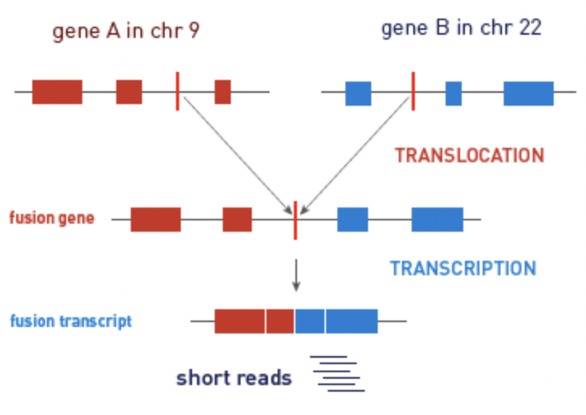
Alignment/Mapping: STAR tool
STAR (Spliced Transcripts Alignment to a Reference (STAR))
is popular for RNA-Seq data because it
does unbiased de novo detection of canonical junctions
can discover non-canonical splices
can discover chimeric (fusion) transcripts
Tools: STAR, HISAT2, TopHat2, bowtie2, salmon, kallisto

Slide 68
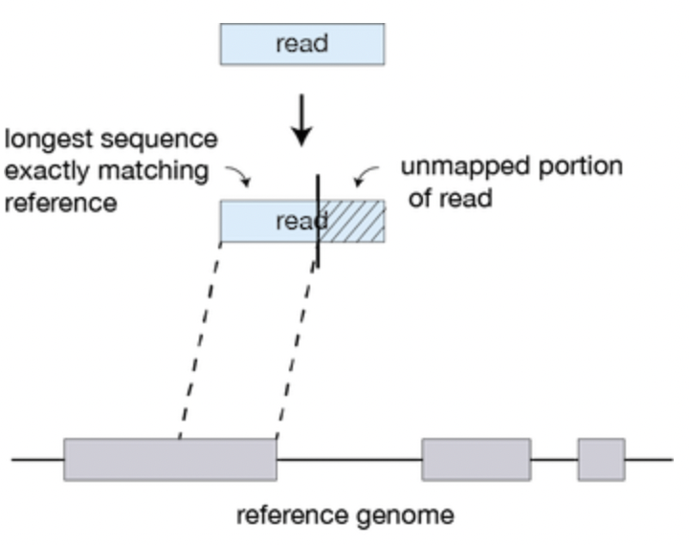
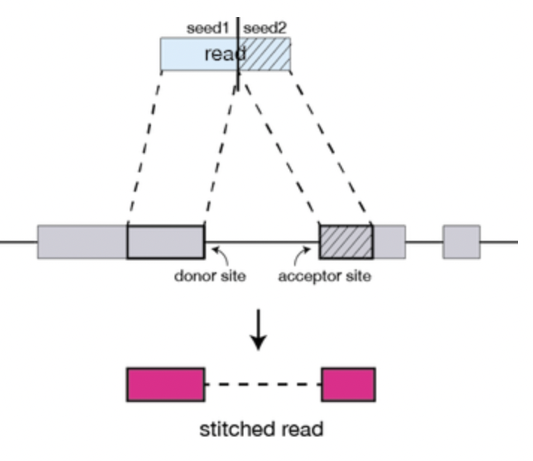
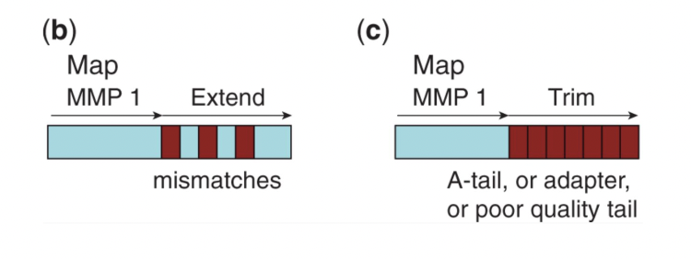
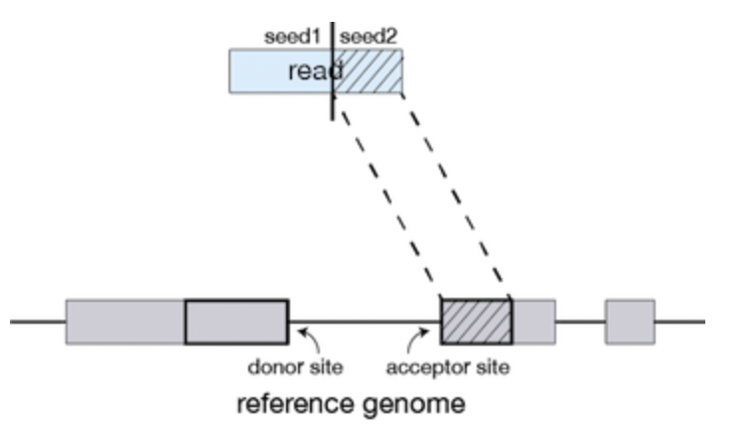
Alignment/Mapping: How does STAR work?
Step 1: Seed search
Step 2: Stitching and scoring
MMP1
MMP1
MMP = Maximum Mappable Prefix
Anchor seeds in a genomic region
Image source: https://hbctraining.github.io/Intro-to-rnaseq-hpc-O2/lessons/03_alignment.html
Notes:
https://www.ncbi.nlm.nih.gov/pmc/articles/PMC3530905/

Slide 69
Alignment/Mapping: Inputs needed
Reads to align
  FASTQ file after cleaning (trimming adapters).
Reference sequence to align to
  Example – “rDNA_sequence.fasta”
  FASTA format. Two lines per sequence.
    Starting with “>”, followed by sequence name/identifier.
    Sequence.
  File extensions: .fasta, .fa, .txt.
  Examples of acceptable genome sequence files for STAR:
    ENSEMBL: files marked with .dna.primary.assembly
    GENCODE: files marked with PRI (primary). Strongly recommended for mouse and human.
Notes:
Examples of acceptable genome sequence files:
ENSEMBL: files marked with .dna.primary.assembly, such as: ftp://ftp.ensembl. org/pub/release-77/fasta/homo_sapiens/dna/Homo_sapiens.GRCh38.dna.primary_ assembly.fa.gz
GENCODE: files marked with PRI (primary). Strongly recommended for mouse and human: http://www.gencodegenes.org/.

Slide 70
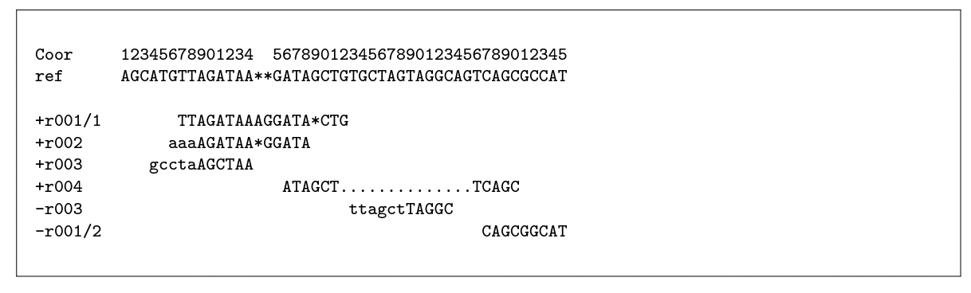

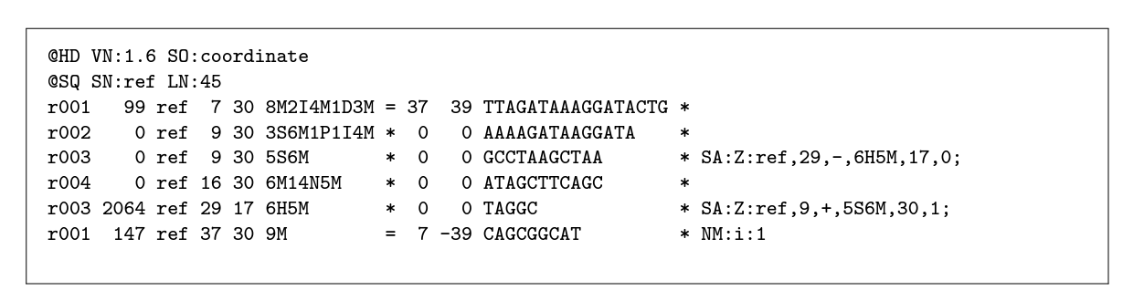
From the alignment to SAM format
Alignment
SAM
CIGAR string
Notes:
chrome-extension://efaidnbmnnnibpcajpcglclefindmkaj/https://samtools.github.io/hts-specs/SAMv1.pdf

Slide 71
Sequence Alignment/Map (SAM) format
Alignments in SAM format - a summary of mapping statistics
How many reads mapped?
How many unmapped?
...
First few lines contain metadata about alignments.
  These lines start with “@”.
  Example – version of file format, sorting order of alignments, grouping, etc.
After header, a table of alignments of each read to the genome.
Alignment reports often very large files.
Binary Alignment/Map (BAM) extension used for compressed SAM files.
Indexed BAM -> BAI
Notes:
Suggested reading:
https://samtools.github.io/hts-specs/SAMv1.pdf

Slide 72
Pseudo-aligners identify the transcript that originated the read
Much, much faster
Less memory intensive than STAR
They are called "pseudo" aligners because they do not perform the full alignment of each sequencing read to a reference genome or transcriptome.
Pseudoaligners use a reference transcriptome to create a set of potential transcript sequences or exonic regions, respectively. Then, they map the reads to these sequences without attempting to align each read to its exact position in the reference.
Examples of tools: Salmon, Kallisto
Notes:
Kallisto: https://www.nature.com/articles/nbt.3519
Salmon: https://www.ncbi.nlm.nih.gov/pmc/articles/PMC5600148/

Slide 73
Biological question
Library preparation
Sequencer: Reads Fastq
Quality check
FastQC
Session 1 Demo
Session 1 Concepts:
Trimming
cutadapt
Quality check
FastQC
Alignment/Mapping
STAR
Quality check
Session 2 Concepts:
Session 2 Demo
Counting Reads
featureCounts
Quality check
Count Matrix
Notes:
Sequencing centers often provide reads in the FASTQ format. The raw reads contain sequences of adapters added during library preparation, which are trimmed to start with. Then, the reads are typically mapped to a reference genome sequence. Counts of reads mapping to genes are tallied and used for differential gene expression analysis. At all stages, it is important to perform quality control of the data. All the tools mentioned in the subsequent slides for these steps are available via docker or can be installed locally.
Please download and install Docker Desktop from: https://docs.docker.com/get-docker/
All UCSF/Gladstone affiliates can request access to Wynton. Visit https://wynton.ucsf.edu/hpc/about/join.html

Slide 74
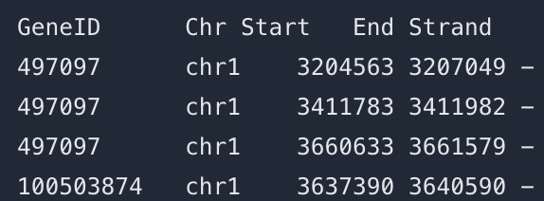
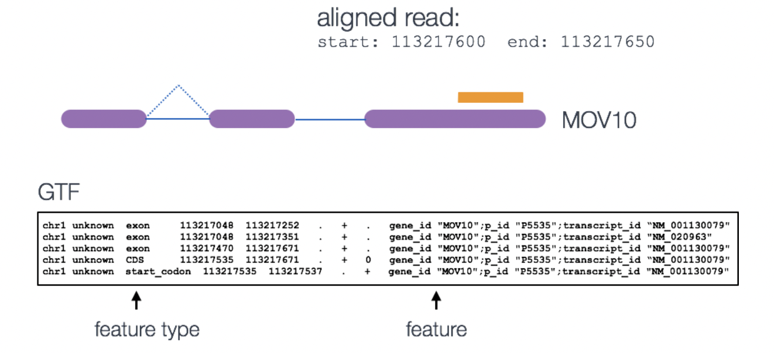
featureCounts
Input:
  Alignment BAM file
  Annotation SAF/GFF/GTF file
SAF
meta-feature is the aggregation of a set of features with the same gene_id

Slide 75
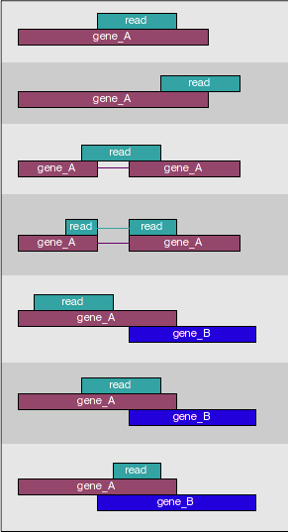
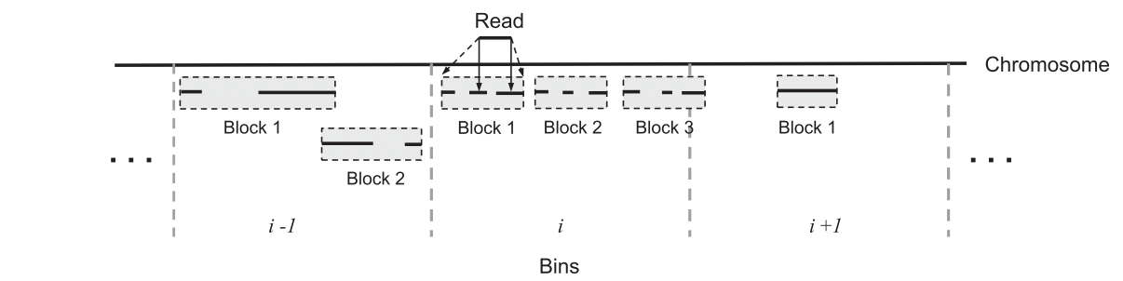
How many reads overlap annotated regions?
Use featureCounts
Narrow down the genomic region that could contain features overlapping with the query read
Hierarchical data structure - features within blocks within bins
Notes:
Suggested reading:
https://academic.oup.com/bioinformatics/article/30/7/923/232889

Slide 76
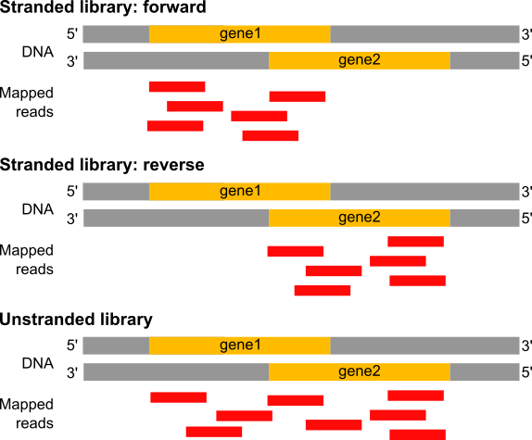
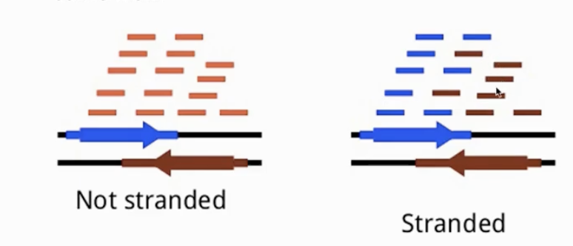
Estimation of the strandness - directionality of the RNA molecule
In a stranded forward library, reads map mostly on the genes located on forward strand (here gene1).
With stranded reverse library, reads map mostly on genes on the reverse strand (here gene2).
With unstranded library, reads maps on genes on both strands.
Image source: https://training.galaxyproject.org/training-material/
Notes:
Suggested reading:
https://www.ncbi.nlm.nih.gov/pmc/articles/PMC3005310/
https://blog.genewiz.com/stranded-vs-non-stranded-rna-seq

Slide 77
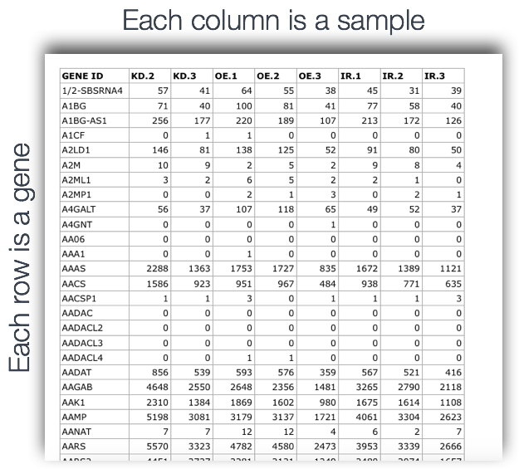
featureCounts output
  count matrix (text file)
  a summary file

Slide 78
Break (5 min)
Need help? Please drop a question in the chat or speak up

Slide 79
RNA-seq - analysis workflow
Biological question
Library preparation
Sequencer: Reads Fastq
Quality check
FastQC
Session 1 Demo
Session 1 Concepts:
Trimming
cutadapt
Quality check
FastQC
Alignment/Mapping
STAR
Quality check
Session 2 Concepts:
Session 2 Demo
Counting Reads
featureCounts
Quality check
Count Matrix
Notes:
Sequencing centers often provide reads in the FASTQ format. The raw reads contain sequences of adapters added during library preparation, which are trimmed to start with. Then, the reads are typically mapped to a reference genome sequence. Counts of reads mapping to genes are tallied and used for differential gene expression analysis. At all stages, it is important to perform quality control of the data. All the tools mentioned in the subsequent slides for these steps are available via docker or can be installed locally.
Please download and install Docker Desktop from: https://docs.docker.com/get-docker/
All UCSF/Gladstone affiliates can request access to Wynton. Visit https://wynton.ucsf.edu/hpc/about/join.html

Slide 80
Demo using Docker
Run STAR to align the reads to the reference genome
Run featureCounts to tally counts

Slide 81
Real data is complex
Session I and II provides an introduction to typical RNA-seq analysis steps using an artificial dataset.
Real data might need additional analyses choices.
Possible challenges with real data: (What we did not cover today)
  What to do you if only 50%of reads align to reference?
  What to do if FastQC reports unusual GC content?
  What to do if the reference genome is incomplete?
  How to deal with more complicated experimental designs?
  How many replicates to use for RNA-seq?
Some analysis choices need experience. Consult with the Gladstone Bioinformatics core for such scenarios and data.
Notes:
E.g: The argument choices available for STAR

Slide 82
Production-ready pipelines: nf-core/rnaseq
What you will learn today:
Individual tools (FastQC, cutadapt, STAR, featureCounts)
What we use at Gladstone Bioinformatics Core:
Automated pipelines (nf-core/rnaseq)
• Runs all steps automatically
• Handles batch processing (100+ samples)
• Built-in best practices
• Comprehensive quality reports
🔗 nf-core/rnaseq documentation:
https://nf-co.re/rnaseq

Slide 83
Session I and II
Take-home messages
Each steps of the analysis can be affected by some kind of bias - Check the quality after each step!
Know the tools and how they work. Use best practices for the analysis.
What we covered so far:
Common tools, e.g., fastqc, cutadapt, STAR
Common file formats, e.g., FASTQ, FASTA, SAM, GTF, BAM
Analysis on your computer using docker

Slide 84
If you are not able to attend
Session III tomorrow at 1.05p
Please take the survey
https://www.surveymonkey.com/r/bioinfo-training26

Slide 85
Introduction to RNA-seq data analysis
Michela Traglia, Ayushi Agrawal
Bioinformatics Core, GIDB
September 28-29, 2026

Slide 86
Working material for this workshop
Session I-II-III
Slides
Session I-II - Hands-on materials
Session III - Hands-on materials

Slide 87
Hands-on session III files
- 2026Fall_RNAseq_SessionIII_handson.R #each step in R
- targets.txt #sample sheet
- DE_result_handson.txt #results table
- GSE60450_Lactation-GenewiseCounts.txt.gz #count matrix

Slide 88
Session 3
From count matrix to DEGs

Slide 89
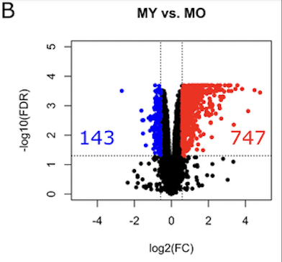
From the count matrix to the DEG

Slide 90
Workshop outline
Session I
RNA-seq analysis overview
Understanding the sequencer output
Quality checks
Trimming of adapters
Break
Introduction to docker and setup
Demo - QC steps
Session II
Mapping the read to reference genome
From alignment to counting features
Break
Demo - from Mapping to the count matrix
Session III
Filtering low counts genes
Dimensionality reduction
Normalization
Break
Model fitting
DEG and visualization
Break
Demo - from count matrix to DEG

Slide 91
Count matrix
Source of variability
Filtering low counts genes
Dimensionality reduction
Session 3 Concepts:
Normalization
Fit the model
DEG and visualization
Session 3 Demo
Notes:
Sequencing centers often provide reads in the FASTQ format. The raw reads contain sequences of adapters added during library preparation, which are trimmed to start with. Then, the reads are typically mapped to a reference genome sequence. Counts of reads mapping to genes are tallied and used for differential gene expression analysis. At all stages, it is important to perform quality control of the data. All the tools mentioned in the subsequent slides for these steps are available via docker or can be installed locally.
Please download and install Docker Desktop from: https://docs.docker.com/get-docker/
All UCSF/Gladstone affiliates can request access to Wynton. Visit https://wynton.ucsf.edu/hpc/about/join.html

Slide 92
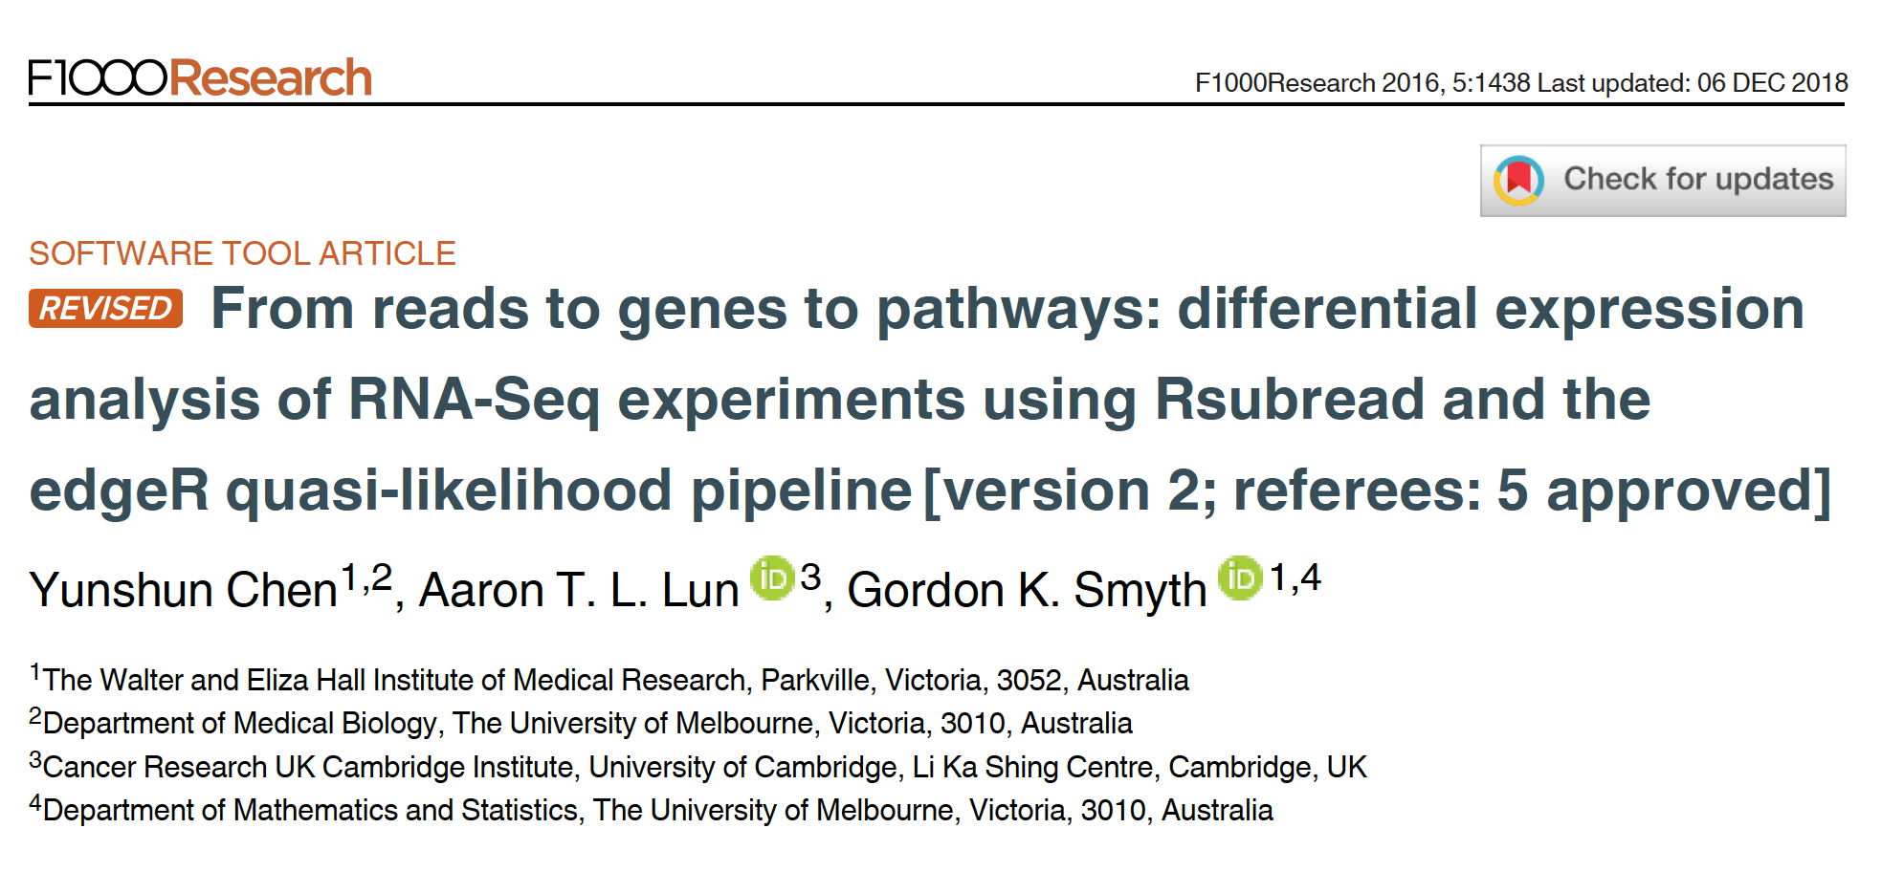
Reference for the workshop
Notes:
Relevant reading for theory:
1. Chen, Yunshun, Aaron TL Lun, and Gordon K. Smyth. "Differential expression analysis of complex RNA-seq experiments using edgeR." Statistical analysis of next generation sequencing data. Springer, Cham, 2014. 51-74.

Slide 93

Dataset
Transcriptome analysis of luminal and basal cell subpopulations in the lactating versus pregnant mammary gland
GEO (gene expression omnibus) accession: GSE60450
https://www.ncbi.nlm.nih.gov/gds
Tissue of origin: Mammary glands of mouse
Cell types: Basal stem-cell enriched cells (B) and committed luminal cells (L)
Biological conditions: Virgin, Lactating (2 day) and Pregnant (18.5 day)
# of groups: 2 cell types (B/L) x 3 conditions (V/L/P) = 6 groups
# of replicates: 2 of each group
Illumina Hiseq sequencer - about 30 million 100bp single-end reads for each sample.

Slide 94
Count matrix
Source of variability
Filtering low counts genes
Dimensionality reduction
Session 3 Concepts:
Normalization
Fit the model
DEG and visualization
Session 3 Demo
Notes:
Sequencing centers often provide reads in the FASTQ format. The raw reads contain sequences of adapters added during library preparation, which are trimmed to start with. Then, the reads are typically mapped to a reference genome sequence. Counts of reads mapping to genes are tallied and used for differential gene expression analysis. At all stages, it is important to perform quality control of the data. All the tools mentioned in the subsequent slides for these steps are available via docker or can be installed locally.
Please download and install Docker Desktop from: https://docs.docker.com/get-docker/
All UCSF/Gladstone affiliates can request access to Wynton. Visit https://wynton.ucsf.edu/hpc/about/join.html

Slide 95


Slide 96

Source of variability
Visualize replicates using s MD or MA plot
gene 1
Sample A - expression gene 1
Sample B - expression gene 1
Log2 differences sample A and sample B
Average expression between sample A and sample B

Slide 97

We need to detect and correct for the sources of bias
Sample A has more counts assigned to these 3 genes compared to sample B
Sample A
Sample B
Source of bias: Sequencing depth (or library size or total number of reads) of each sample

Slide 98
Different sequence depths may cause variation in counts
Variation in sequencing depths => Need to normalize counts
Group | Total counts
B.virgin | 23085177
B.virgin | 21628857
B.pregnant | 23919152
B.pregnant | 22490570
B.lactating | 21382233
B.lactating | 19884434
Group | Total counts
L.virgin | 20213223
L.virgin | 21509988
L.pregnant | 22073815
L.pregnant | 21837341
L.lactating | 24638939
L.lactating | 24581591
Library size about 20M

Slide 99



Sequence depth/Library size - Count Per Million mapped reads
Sequenced one library with 5 million(M) reads.
Total 4 M matched to the genome sequence
5000 reads matched to a given gene
Filter on count-per-million (CPM) values to avoid favoring genes that are expressed in larger libraries over those expressed in smaller libraries
A gene at least 10–15 counts in at least some libraries before it is considered to be expressed -> Identifying the CPM that corresponds to 10-15 counts

Slide 100
logCPM values allow
Accounting for sequencing depth
Filtering out low counts genes
Visualizing inter sample variability
Not the correct normalization for DEG analysis

Slide 101
Count matrix
Source of variability
Filtering low counts genes
Dimensionality reduction
Session 3 Concepts:
Normalization
Fit the model
DEG and visualization
Session 3 Demo
Notes:
Sequencing centers often provide reads in the FASTQ format. The raw reads contain sequences of adapters added during library preparation, which are trimmed to start with. Then, the reads are typically mapped to a reference genome sequence. Counts of reads mapping to genes are tallied and used for differential gene expression analysis. At all stages, it is important to perform quality control of the data. All the tools mentioned in the subsequent slides for these steps are available via docker or can be installed locally.
Please download and install Docker Desktop from: https://docs.docker.com/get-docker/
All UCSF/Gladstone affiliates can request access to Wynton. Visit https://wynton.ucsf.edu/hpc/about/join.html

Slide 102

Filtering
Potential biological questions
Which comparisons are we interested in?
Example:
B vs L,
B.lactating vs L.pregnant,
...
All of them
Or not interested in comparisons but in gene expression of one sample

Slide 103

Issue: genes with low counts
Can we make reliable inferences for genes with very low counts? What should we consider “very low”?

Slide 104

“Uninteresting” genes
Filtering
Biological point of view: minimal expression level of a gene -> translation into a protein -> biologically relevant
Statistical point of view: low counts -> not enough statistical evidence.
Genes with consistently low counts are very unlikely be assessed as significantly DE
Using cpm to filter out genes

Slide 105
Need to correct for multiple testing
P value represents the chance that we may be wrong in calling something significantly differential. Example:
  P = 0.01 means 1% chance that we may be wrong.
More than 20k genes under consideration
=> if a certain difference in expression levels has only 1% chance of happening given the null model, it
might be observed for 200 genes even if the null model were true for all the genes.
=> 200+ false positives
Hence, there is a need to adjust the p-values.
  - The more genes we test, the more we must adjust.
  - Reduce the number of tests by filtering out “uninteresting” genes.

Slide 106
Count matrix
Source of variability
Filtering low counts genes
Dimensionality reduction
Session 3 Concepts:
Normalization
Fit the model
DEG and visualization
Session 3 Demo
Notes:
Sequencing centers often provide reads in the FASTQ format. The raw reads contain sequences of adapters added during library preparation, which are trimmed to start with. Then, the reads are typically mapped to a reference genome sequence. Counts of reads mapping to genes are tallied and used for differential gene expression analysis. At all stages, it is important to perform quality control of the data. All the tools mentioned in the subsequent slides for these steps are available via docker or can be installed locally.
Please download and install Docker Desktop from: https://docs.docker.com/get-docker/
All UCSF/Gladstone affiliates can request access to Wynton. Visit https://wynton.ucsf.edu/hpc/about/join.html

Slide 107

Assessing overall similarity across samples
Which samples are similar to each other, which are different?
Does this fit to the expectation from the experiment’s design?
What are the major sources of variation in the dataset?
Get the set of the most variable genes across samples and PCA using logCPM
Notes:
Biological phenomena more likely driven by sets of genes than individual genes
Dimensions = Number of coordinates of data points = Number of genes
=> Too many to visualize
Cells may be separated in the direction of hidden “factors”
=>1st dimension: disease-associated pathway
=>2nd dimension another hidden factor, e.g., batch effect
PC1 is the projection direction that maximizes the variance of the projected data
PC2 is the projection direction that is orthogonal to PC1 and maximizes variance of the projected data

Slide 108

Expression level of Casein varies in a way that is strongly indicative of the effect of CellType and Status
Why are the B.lactating samples not close to B.virgin and B.pregnant samples?
Could it be due to batch effects?

Slide 109

Expression appears to vary across samples but…
In general, the way expression appears to vary across samples could be dominated by noise, batch effects, real signal, etc.
Identify the source for technical variability!

Slide 110
Count matrix
Source of variability
Filtering low counts genes
Dimensionality reduction
Session 3 Concepts:
Normalization
Fit the model
DEG and visualization
Session 3 Demo
Notes:
Sequencing centers often provide reads in the FASTQ format. The raw reads contain sequences of adapters added during library preparation, which are trimmed to start with. Then, the reads are typically mapped to a reference genome sequence. Counts of reads mapping to genes are tallied and used for differential gene expression analysis. At all stages, it is important to perform quality control of the data. All the tools mentioned in the subsequent slides for these steps are available via docker or can be installed locally.
Please download and install Docker Desktop from: https://docs.docker.com/get-docker/
All UCSF/Gladstone affiliates can request access to Wynton. Visit https://wynton.ucsf.edu/hpc/about/join.html

Slide 111
Normalization approach to identify DE genes: edgeR
Bioconductor package edgeR
Null model - differences due to noise in counts data
If the probability is very low (e.g., p < 0.05), infer that something may be happening that we did not account for in the null model. (e.g., biological processes in L cells for milk production) - biological signal
Notes:
p-value is the probability of an observed (or more extreme) result assuming that the null hypothesis is true
For all the details see: http://bioconductor.org/packages/devel/bioc/vignettes/edgeR/inst/doc/edgeRUsersGuide.pdf

Slide 112

To perform DEG - additional source of bias to account for
Library size 1M
Sample A (where the gene is overexpressed)
Gene DE 500,000 raw counts
All other genes 500,000
Sample B (where the gene is not overexpressed)
Gene DE 10,000 raw counts
All other genes 990,000
If a gene is overexpressed in one group of samples, the other genes look lower expressed
Different RNA sample composition
Cells don’t necessarily produce similar levels of RNA/cell between cell types, disease states or developmental stages is not always valid

Slide 113


Highly expressed genes bias the real DEG
Total read count for each sample is the same.
Few highly expressed genes make up a greater share of the total molecules (total library size) of samples B.
Smaller fraction of the reads will be left for the other genes for that samples (undersampling).
Normalization for DEG: TMM (edgeR), RLE (DESeq)
doi: 10.1093/bib/bbx008

Slide 114

A few highly differentially expressed genes may have a strong influence on read counts -> minimizing effect of such genes
Assumption: A majority of transcripts is not differentially expressed
Adjust counts such that for most genes, counts are not differential.
Normalize for RNA composition by a set of scaling factors that minimize the log-fold changes between the samples for most genes.

Slide 115
Approach to identify DE genes: edgeR
Scaling factors to minimize the log-fold changes between the samples for most genes
Reference sample: have the closest average expressions to the mean of all samples
Test samples: other samples
Generate a gene set removing most/lowest expressed genes (avg read counts) and genes with highest/lowest log ratios (differences in expression)

Slide 116



Normalization with edgeR: Trimmed Mean of M-values
MA (mean-difference) plot
TMM is implemented in edgeR and performs best for between-samples comparisons, when comparing the samples from different tissues or genotypes.
y <- calcNormFactors(y)
Notes:
Another approach is TMM˜[15], which measures the trimmed mean of M and A values (M values are the log fold change in the number of reads aligning to a region of interest measured relative to an average or arbitrary sample, A is the average count of a gene; the trimmed mean discards regions of interest that have extreme M or A values and calculates the mean M value of the remainder); the inverse of this mean is used to weight samples.
To see how the weights are calculated:
𝑀=log_2⁡(𝑋_2/𝑁_2 )−log_2⁡(𝑋_𝑟𝑒𝑓/𝑁_𝑟𝑒𝑓 )
⇒𝑉𝑎𝑟(𝑀)=𝑉𝑎𝑟_2+𝑉𝑎𝑟_𝑟𝑒𝑓, where 𝑉𝑎𝑟_𝑟𝑒𝑓=𝑉𝑎𝑟(log_2⁡(𝑋_𝑟𝑒𝑓/𝑁_𝑟𝑒𝑓 ) )
and 𝑉𝑎𝑟_2=𝑉𝑎𝑟(log_2⁡(𝑋_2/𝑁_2 ) ).
Assume 𝑁_2 and 𝑁_𝑟𝑒𝑓 are constant.
⇒𝑉𝑎𝑟_2=𝑉𝑎𝑟(log_2⁡(𝑋_2 ) )
and, 𝑉𝑎𝑟_𝑟𝑒𝑓=𝑉𝑎𝑟(log_2⁡(𝑋_𝑟𝑒𝑓 ) )
Note:
a. 𝑉𝑎𝑟(𝑋)=𝑋(1−𝑋/𝑁) if 𝑋 is binomially distributed.
b. In general, if 𝑌=𝑎𝑋, then 𝑉𝑎𝑟(𝑌)=𝑎^2 𝑉𝑎𝑟(𝑋).
c. The slope of log_2⁡〖(𝑥)〗 at some 𝑥_0 is proportional to 1/𝑥_0 .
⇒𝑉𝑎𝑟∝(1/𝑋)^2.𝑋(1−𝑋/𝑁)
=(𝑁−𝑋)/𝑁𝑋

Slide 117
Other approaches to normalization
Relative Log Expression (RLE) approach by Anders and Huber (2010)
  Reference: geometric mean of all samples
  Normalization factor: median ratio of each sample to the reference
  RLE and TMM give similar robust results with real and simulated data
  R package DESeq - tutorial
Upper quartile normalization by Bullard et al (2010)
  Normalization factor: 75% quantile of the counts for each sample
  Not recommended in general - implies a similarity between RNA molecular repertoires expressed
Control genes (housekeeping genes, spike-in) to estimate technical noise (RUVSeq – 2014 Remove Unwanted Variation)
  powerful when a large set of control genes can be identified
Notes:
More about normalization methods: https://bmcgenomics.biomedcentral.com/articles/10.1186/s12864-020-6502-7
Relative Log Expression - Anders, S, Huber, W (2010). Differential expression analysis for sequence count data. Genome Biology 11, R106.
Bullard JH, Purdom E, Hansen KD, Dudoit S. (2010) Evaluation of statistical methods for normalization and differential expression in mRNA-Seq experiments. BMC Bioinformatics 11, 94.
RUVSeq https://bioconductor.org/packages/devel/bioc/manuals/RUVSeq/man/RUVSeq.pdf

Slide 118
Break (5 min)

Slide 119
Poll 6
What is the purpose of TMM normalization in edgeR?
1. To remove lowly expressed genes
2. To correct for compositional bias between samples
3. To convert counts to log2 fold changes

Slide 120
Count matrix
Source of variability
Filtering low counts genes
Dimensionality reduction
Session 3 Concepts:
Normalization
Fit the model
DEG and visualization
Session 3 Demo
Notes:
Sequencing centers often provide reads in the FASTQ format. The raw reads contain sequences of adapters added during library preparation, which are trimmed to start with. Then, the reads are typically mapped to a reference genome sequence. Counts of reads mapping to genes are tallied and used for differential gene expression analysis. At all stages, it is important to perform quality control of the data. All the tools mentioned in the subsequent slides for these steps are available via docker or can be installed locally.
Please download and install Docker Desktop from: https://docs.docker.com/get-docker/
All UCSF/Gladstone affiliates can request access to Wynton. Visit https://wynton.ucsf.edu/hpc/about/join.html

Slide 121
How to fit the model using the normalized RNA-seq red counts
Model the read mapped to a given gene (Y) and estimate the differences between the two groups/conditions.
Y ~ group (B.Lactating vs B.Pregnant mice)
Total number of reads for a sample ~ millions
Counts per gene ~ tens /hundreds /thousands.
The chance of a given read to be mapped to any specific gene is rather small.
Discrete events sampled out of a large pool with low probability are usually modeled with Poisson distribution

Slide 122

Modeling the read counts mapped to a gene
The number of reads mapped to a gene was first modeled using a Poisson distribution (Marioni et al. (2008))
Assumption: assumes that mean and variance are the same
BUT the variance grows faster than the mean in RNAseq data.
Biological data show more variability than Poisson allows
Pooled gene-level variance
Mean gene expression level
Why?

Slide 123

Dispersion controls how much biological variability exists between replicates
Underestimation of the biological variance increased the probability to falsely declare a gene DE when it is non-DE (type I error rate)
Negative binomial (NB) distribution
-> alternative to model the read counts for each gene in each sample
The variance is always larger than the mean for the negative binomial ⇒ suitable for RNA-seq data

Slide 124
edgeR estimates 3 dispersions
Dispersion φ accounts for the variability between biological replicates
Common dispersion: a global dispersion estimate averaged across the genes
Assumption: every gene has the same biological variability
Not enough because:
  counts from biological replicates vary
  variance is exceeding the mean for highly expressed genes
  low counts are noisy
  some genes have stable variance
n
Notes:
plotBCV() plots the tagwise biological coefficient of variation (square root of dispersions) against log2-CPM.
https://smartech.gatech.edu/bitstream/handle/1853/35125/efron_videostream.html?sequence=8&isAllowed=y
Robbins, Herbert. An Empirical Bayes Approach to Statistics. Proceedings of the Third Berkeley Symposium on Mathematical Statistics and Probability, Volume 1: Contributions to the Theory of Statistics, 157--163, University of California Press, Berkeley, Calif., 1956. https://projecteuclid.org/euclid.bsmsp/1200501653
http://seqanswers.com/forums/showthread.php?t=5591
See other example of tagwise dispersion DOI:10.1371/journal.pone.0119254

Slide 125
Genes with similar expression tend to have similar biological variability
Trended dispersion: dispersion of a gene is predicted from its abundance – similar abundant genes
  Low counts -> high dispersion
  Higher counts -> lower dispersion
Genes with similar abundance levels get similar dispersion estimates
Notes:
plotBCV() plots the tagwise biological coefficient of variation (square root of dispersions) against log2-CPM.
https://smartech.gatech.edu/bitstream/handle/1853/35125/efron_videostream.html?sequence=8&isAllowed=y
Robbins, Herbert. An Empirical Bayes Approach to Statistics. Proceedings of the Third Berkeley Symposium on Mathematical Statistics and Probability, Volume 1: Contributions to the Theory of Statistics, 157--163, University of California Press, Berkeley, Calif., 1956. https://projecteuclid.org/euclid.bsmsp/1200501653
http://seqanswers.com/forums/showthread.php?t=5591
See other example of tagwise dispersion DOI:10.1371/journal.pone.0119254

Slide 126

A smooth curve summarizing variability overall
Tagwise dispersion: measure of the degree of consistent inter-library variation for that tag( gene)
Problem: Gene-specific dispersion estimates are noisy.
EB shrinkage to the trended dispersion - between overall abundance trend and gene specific estimate
Empirical Bayes estimates need to be controlled for the possibility of outlier genes with exceptionally large or small individual dispersions (robust=TRUE)
The tag-wise dispersions (orange dots) are the result of shrinking the gene-wise dispersion (black dots) to the trend (blue line)
plotBCV
biological coeff variation
BCV ≈ relative variability between samples
y <- estimateDisp(y, design)
Notes:
plotBCV() plots the tagwise biological coefficient of variation (square root of dispersions) against log2-CPM.
https://smartech.gatech.edu/bitstream/handle/1853/35125/efron_videostream.html?sequence=8&isAllowed=y
Robbins, Herbert. An Empirical Bayes Approach to Statistics. Proceedings of the Third Berkeley Symposium on Mathematical Statistics and Probability, Volume 1: Contributions to the Theory of Statistics, 157--163, University of California Press, Berkeley, Calif., 1956. https://projecteuclid.org/euclid.bsmsp/1200501653
http://seqanswers.com/forums/showthread.php?t=5591
See other example of tagwise dispersion DOI:10.1371/journal.pone.0119254

Slide 127


Fitting the model : glmQLFit
NB dispersions - higher for genes with very low counts - decrease smoothly with abundance and asymptotically to a constant value for genes with larger counts
NB dispersion trend is used to describe the overall biological variability (fit GLM)
EB shrunk to the trend
QL extension to account for extra gene-specific variability above and below the overall level - reflects how much each gene deviates from the expected variability

Slide 128
edgeR fitting models
QL for bulk RNA-seq:
+ stricter error rate control (more rigorous dispersion and uncertainty)
+ speed improvement compared to other quasi-methods
+ for multiple treatment factors and with small # of biological replicates
+ relative changes in expression levels between conditions (not absolute)
Limma package for large scale datasets – high overlap across methods
Notes:
https://www.bioconductor.org/packages/release/bioc/vignettes/edgeR/inst/doc/edgeRUsersGuide.pdf
Quasi likelihood https://pubmed.ncbi.nlm.nih.gov/23104842/
About limma /edgeR / Deseq2 differenceS: chrome-extension://efaidnbmnnnibpcajpcglclefindmkaj/https://www.e3s-conferences.org/articles/e3sconf/pdf/2021/47/e3sconf_icepe2021_03058.pdf

Slide 129
Poll 7
Why is RNA-seq count data modeled using a Negative Binomial distribution instead of Poisson?
NB is faster than Poisson
The variability between biological replicates is larger than expected according to a Poisson model
Poisson cannot model fold changes

Slide 130
Count matrix
Source of variability
Filtering low counts genes
Dimensionality reduction
Session 3 Concepts:
Normalization
Fit the model
DEG and visualization
Session 3 Demo
Notes:
Sequencing centers often provide reads in the FASTQ format. The raw reads contain sequences of adapters added during library preparation, which are trimmed to start with. Then, the reads are typically mapped to a reference genome sequence. Counts of reads mapping to genes are tallied and used for differential gene expression analysis. At all stages, it is important to perform quality control of the data. All the tools mentioned in the subsequent slides for these steps are available via docker or can be installed locally.
Please download and install Docker Desktop from: https://docs.docker.com/get-docker/
All UCSF/Gladstone affiliates can request access to Wynton. Visit https://wynton.ucsf.edu/hpc/about/join.html

Slide 131
Get the DE genes - glmQLFTest and glmTreat
Identifies differential expression based on statistical significance regardless of how small the difference might be -> 5000 DE genes between condition and control groups
Interested only in genes with large expression changes -> subset of genes more biologically meaningful.
Modify the statistical test to evaluate variability as well as the magnitude of change of expression values -> expression changes greater than a specified threshold
Not equivalent to a simple fold change cutoff : “the fold-change below which we are definitely not interested in the gene”
The total number of DE genes identified at an FDR of 5% can be shown with decideTest() – set cutoff

Slide 132

Get the DE genes - glmQLFTest and glmTreat
Complicated contrasts - makeContrasts()
- between lactating and pregnant mice is the same for basal cells as it is for luminal cells
- the interaction effect between mouse status and cell type

Slide 133

Visualization
From Barham et al 2013
Volcano plot
MA (mean-difference) plot
From Barham et al 2013
Heatmap
Identify genes (and molecular pathways) that are differentially expressed (DE) between two or more biological conditions
Notes:
Ma plot from https://rpkgs.datanovia.com/ggpubr/reference/ggmaplot.html
MA-plot is a scatter plot of log2 fold changes (M, on the y-axis) versus the average expression signal (A, on the x-axis). M = log2(x/y) and A = (log2(x) + log2(y))/2 = log2(xy)*1/2, where x and y are respectively the mean of the two groups being compared.

Slide 134
Count matrix
Source of variability
Filtering low counts genes
Dimensionality reduction
Session 3 Concepts:
Normalization
Fit the model
DEG and visualization
Session 3 Demo
Notes:
Sequencing centers often provide reads in the FASTQ format. The raw reads contain sequences of adapters added during library preparation, which are trimmed to start with. Then, the reads are typically mapped to a reference genome sequence. Counts of reads mapping to genes are tallied and used for differential gene expression analysis. At all stages, it is important to perform quality control of the data. All the tools mentioned in the subsequent slides for these steps are available via docker or can be installed locally.
Please download and install Docker Desktop from: https://docs.docker.com/get-docker/
All UCSF/Gladstone affiliates can request access to Wynton. Visit https://wynton.ucsf.edu/hpc/about/join.html

Slide 135
Dataset
Transcriptome analysis of luminal and basal cell subpopulations in the lactating versus pregnant mammary gland
GEO (gene expression omnibus) accession: GSE60450
Tissue of origin: Mammary glands of mouse
Cell types: Basal stem-cell enriched cells (B) and committed luminal cells (L)
Biological conditions: Virgin, Lactating (2 day) and Pregnant (18.5 day)
# of groups: 2 cell types (B/L) x 3 conditions (V/L/P) = 6 groups
# of replicates: 2 of each group
Illumina Hiseq sequencer - about 30 million 100bp single-end reads for each sample.
https://www.ncbi.nlm.nih.gov/geo/

Slide 136


Files for the hands-on session
targets.txt
Phenofile
GSE60450_Lactation-GenewiseCounts.txt.gz
Counts for each sample for each gene (Entrez Gene Identifiers)

Slide 137
Demo
Load and reformat the data
Exploratory visualization : MA plot
Create DGElist object and retrieve gene symbols
Filter genes with inadequate information
Normalization
Exploratory visualization : MDS and PCA plots
Define and fit a model
Hypothesis testing (four comparisons)
Save results as a table (open in Excel)

Slide 138
Session III
Take-home messages
Raw counts are not comparable across samples/genes within a sample
Several normalization methods: some more suitable for DEG
Estimate the dispersion, visualize the technical variability
Fit the model: counts variance exceeding the mean
Make all the comparisons that you wish using complicated contrasts
Visualize the DEG and get a list for pathway analysis

Slide 139
What if
Q1. Experimental design with repeated measures - alternative methods
Q2. Batch effects in bulk
Real data might need additional analyses choices that need experience
AI - Core position paper
Consult with the Gladstone Bioinformatics core for such scenarios and data.

Slide 140
Upcoming workshops at Gladstone:
AI fluency for Biologists
October 5-6
Single Cell RNA-Seq Analysis using R
October 12-13
Introduction to Pathway Analysis
October 15
Statistics of Enrichment Analysis Methods
October 22-23
Linear Mixed Effects Models Using R
October 26-27

Slide 141
Your feedback is important to us!
Please take the survey ~3 min:
https://www.surveymonkey.com/r/bioinfo-training26

Slide 143
Additional resources

Slide 144
Helpful resources
Bacterial reference genome:
  https://bacteria.ensembl.org/index.html
  STAR and HISAT2 are more commonly used for eukaryotic RNA-seq. For bacterial RNA-seq data, Bowtie2 and BWA can be used as these are non-spliced reads. STAR can also be used for bacterial RNA-seq data but there some additional STAR options that should be specified when doing so.
How to add reporter sequence to the reference:
  https://groups.google.com/g/rna-star/c/FGQRotrCB1Q
Cutadapt possible adapters types:
  https://cutadapt.readthedocs.io/en/stable/guide.html#adapter-types

Slide 145
Helpful resources
Wynton slack channel
  ucsf-wynton.slack.com
Gladstone Bioinformatics Core slack channel (email us)
  https://gladstoneinstitutes.slack.com/archives/C0145F1L7QS
Wynton tutorials
  https://github.com/ucsf-wynton/tutorials/wiki

Slide 146
Helpful resources
Bacterial reference genome:
  https://bacteria.ensembl.org/index.html
  STAR and HISAT2 are more commonly used for eukaryotic RNA-seq. For bacterial RNA-seq data, Bowtie2 and BWA can be used as these are non-spliced reads. STAR can also be used for bacterial RNA-seq data but there some additional STAR options that should be specified when doing so.
How to add reporter sequence to the reference:
  https://groups.google.com/g/rna-star/c/FGQRotrCB1Q
Cutadapt possible adapters types:
  https://cutadapt.readthedocs.io/en/stable/guide.html#adapter-types

Slide 147
Tools to manipulate files are available
Need to sort alignment report?
  samtools
Need to convert FASTQ to FASTA?
  fastx-toolkit
…
Google!

Slide 148
When I need help, which I do need on a daily basis,
I visit:
Slack channel for Wynton users
  ucsf-wynton.slack.com
https://stackexchange.com/
Google groups for specific tools
GitHub issues
…

Slide 149
How to publish your code?
Tailored Training Sessions on Publishing Your Code with GitHub
Maximize the impact of your research by mastering GitHub with Gladstone's Bioinformatics Core training. The team of experts will help you easily share your code, collaborate with colleagues, publish a function or library, build a website, and more. The core can tailor a training session to meet your lab’s specific needs and bring your research to the next level. Reach out to the core to learn more or set up a training session.
Notes:
https://www.git-tower.com/blog/command-line-cheat-sheet/

Slide 150
Session III Appendix
Notes:
https://www.git-tower.com/blog/command-line-cheat-sheet/

Slide 151

How to the expression for each gene within one sample (Sample A)
Get the expression for each gene within one sample (Sample A)

Slide 152
Scenario
Which gene is more expressed in Sample A? Gene X or Gene Y?
What is the source of bias when comparing Gene X and Gene Y within a sample?

Slide 153

Source of bias between genes
At the same expression level, a long gene will have more reads than a shorter gene
N=12
N=6
Gene-length

Slide 154
Identify and correct technical biases removing the least possible biological signal
  Library size or sequence depth (number of mapped reads)
  Gene length
Commonly used normalization method that includes sequence depth and gene length correction:
  RPKM /FPKM (Reads/Fragments Per Kilobase per Million)
  TPM (Transcripts Per kilobase Million)
Slides in the Appendix

Slide 155



RPKM: seq depth and gene length bias
Reads/Fragments Per Kilobase per Million
One library with 5 M reads
Total 4 M matched to the genome sequence
5000 reads matched to a given gene with a length of 2000 bp.
RPKM and FPKM -> the sum of the normalized reads in each sample may be different, and this makes it harder to compare samples directly.
Notes:
https://www.rna-seqblog.com/rpkm-fpkm-and-tpm-clearly-explained/
RPKM:
Count up the total reads in a sample and divide that number by 1,000,000 – this is our “per million” scaling factor.
Divide the read counts by the “per million” scaling factor. This normalizes for sequencing depth, giving you reads per million (RPM)
Divide the RPM values by the length of the gene, in kilobases. This gives you RPKM.
FPKM is used especially for normalizing counts for paired-end RNA-seq data in which two (left and right) reads are sequenced from the same DNA fragment. Generally, the higher the FPKM of a gene, the higher the expression of that gene.

Slide 156

TPM: seq depth and gene length bias
TPM: Normalize for gene length first to get the Reads Per Kilobase, sum up all the RPK in a sample (across all genes), and then normalize for sequencing depth
Represent the relative abundance of a transcript among a population of sequenced transcripts
The sum of all TPMs in each samples are the same -> to compare the proportion of reads that mapped to a gene in each sample.
Same denominator -> comparable - NOT for RPKM (different denominator)
Sample1 - gene1 TPM=2.5
Sample2 - gene1 TPM=2.5
Notes:
https://translational-medicine.biomedcentral.com/articles/10.1186/s12967-021-02936-w
https://www.biostars.org/p/273537/
https://www.ncbi.nlm.nih.gov/pmc/articles/PMC7373998/
TPM:
Divide the read counts by the length of each gene in kilobases. This gives you reads per kilobase (RPK).
Count up all the RPK values in a sample and divide this number by 1,000,000. This is your “per million” scaling factor.
Divide the RPK values by the “per million” scaling factor. This gives you TPM.

Slide 157

Main normalization approaches summary
Still not enough to perform DEG analysis
https://hbctraining.github.io/Training-modules/planning_successful_rnaseq/lessons/sample_level_QC.html

